Slide 1
Our kind of excellence
Dr Lydia Arnold (with Emily Chapman-Waterhouse)
Nottingham Trent University Festival of Learning
June 2018
@HarperEdDev
www.lydiaarnold.net

Slide 2
What does excellent teaching look like in your context?
Where can you find it?

Slide 3
What is teaching excellence and/or excellent teaching?
“…the effectiveness of academics in enabling students to learn… the level of competence in teaching which maximises learning gain and capacity for original critical thought recognised as exemplary by peers” (Wood & Su, 2017)
Where there is a “high degree of student participation and interaction, a clear structure and passion and enthusiasm in the lecturer” (Revell & Wainwright, 2009)
“Being dynamically engaged in teaching practice and inspiring and practically scaffolding the potential dynamic engagement of one’s students” (Gunn & Fisk, 2013)

Slide 4
Identify a back to basics methodology for locating excellence
Recognise the role of context and culture in teaching excellence
Discuss YOUR kind of excellence

Slide 5

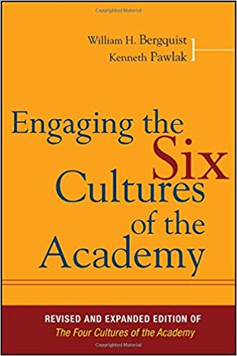
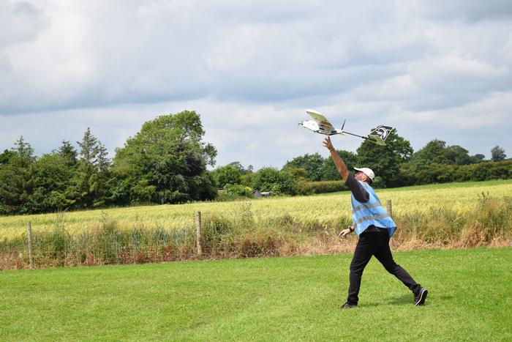

Harper Adams – Cultural Backdrop

Slide 6
Locating excellence:
Bias beware (Trigger: What Works? Thomas et al, 2017)
Cultural fit
  Single culture?
  Reinforcement/Challenge
Reliance on line of sight
  Blind spots
  Loud voices
Creep of expectations
  Normalisation of the novel

Slide 7
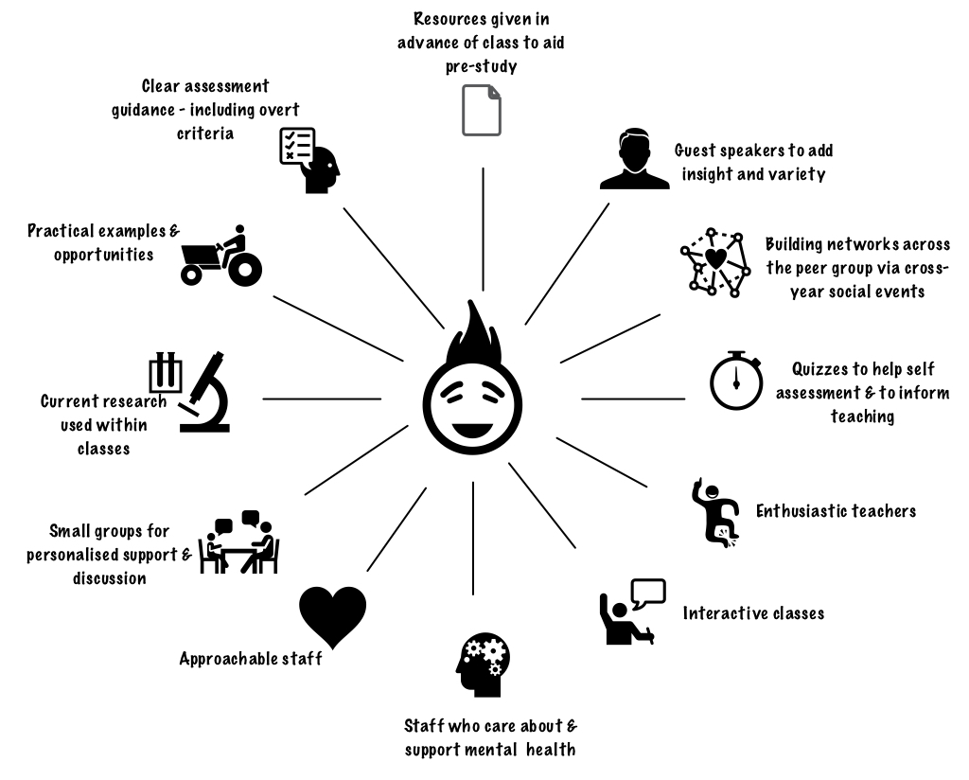
Arnold & Barnett, 2018

Slide 8
Enthusiasm
“[E]nthusiasm is contagious and students absolutely value tutors and professional services staff who are passionate and invested. …there are many ways show enthusiasm and it is not only about appearing as a bouncy, energetic individual “ (Arnold &Barnett, 2018).
Enthusiasm for teaching and the subject = most reported factor from students (Greatbatch and Holland, 2016)

Slide 9
Ask
Analyse
Find
Amplify
Working with excellence

Slide 10
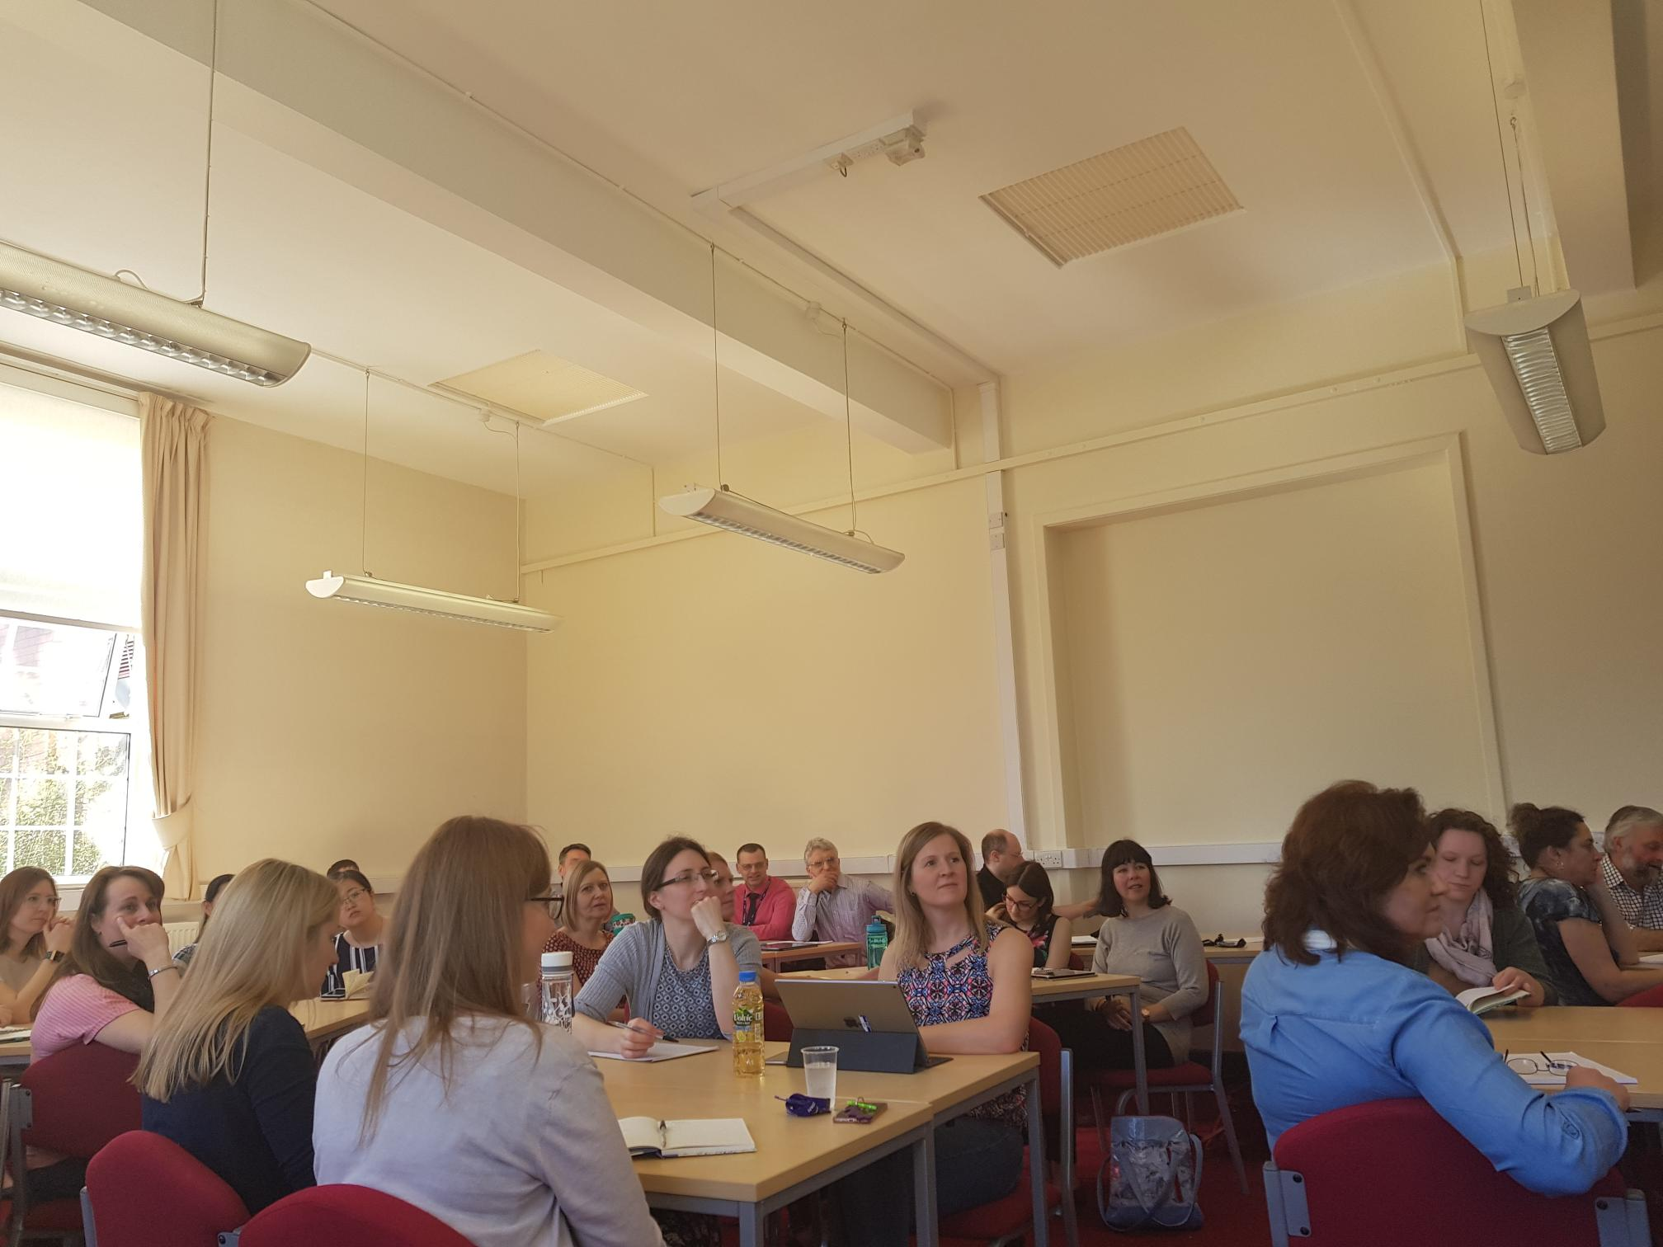
Benefits
Reconnection with the lost
Credible sharing with a ‘mandate’
Inspiration
Connection with culture
Reassurance (Quizzes!)
Stories – oh the stories

Slide 11
A second study ….
What are the barriers and enablers of excellent, impactful teaching?

Slide 12
Phase 1:
Two focus groups, to explore both research questions;
Semi-structured facilitator prompts;
Discussions were recorded and transcribed;
Thematic analysis (TA) of those transcripts on a pairs/peer review basis;
The findings from the focus groups have informed the development of phase two.
Phase 2:
Anonymous online questionnaire delivered via Bristol Online Surveys (BOS) issued to all teaching staff within the department and preceded by a short pilot to test accessibility.
Comprises scaled response and free-text response questions, set to answer both research questions.

Slide 13
Enablers
1. Small groups of students
2. Tech
3. Practical opportunities
4. Students that ask questions/are engaged
5. Staff freedom
6. Online marking and feedback
7. Curriculum fit with professional bodies / employers
8. Inclusion of soft skills

Slide 14
Barriers
1 Students who lack focus
2. Lack of career motivation (family business)
3. Confidence levels of students
4. Unwilling to study independently
1. Large groups
2. Unfamiliar topics
3. Annual changes in teaching allocation
4. Timetabling and room resources
5. Assessment load on staff and students
6. Contrast of cultures between secondary and higher education

Slide 15
Dichotomy devil’s advocate
Excellence is about engagement (in part)
Students can be a barrier to engagement (!?)
Are students are a barrier to excellence? (well of course not …. )

Slide 16
Student
The excellence equation
Tutor
Context

Slide 17
Conclusions
Seek out excellence and amplify it – it’s a change driver
Beware of confusing novel and excellent – the lecture may not be dead just yet!
Use YOUR students to identify excellence
Recognise diversity – excellence in the most unexpected of places!
Counter humility
Explore on the contradictions – what do they tell us about the unsaid!
Consider the excellence equation

Slide 18
Arnold, L and Barnett, S. 2018 in press. Just ask … locating effective teaching practice in Educational Developments. SEDA: London.
De Courcy, E. 2015. Defining and Measuring Teaching Excellence in higher Education in the 21st Century [Online] College Quarterly, v18 n1 Available at https://eric.ed.gov/?id=EJ1070007 Accessed on 21st May 2018
Greatbatch, D. & Holland, J. (2016) Teaching Quality in Higher Education: Literature Review and Qualitative Research. Accessed 25/06/2018 from https://assets.publishing.service.gov.uk/government/uploads/system/uploads/attachment_data/file/5244...
Gunn, V. and Fisk, A. 2013. Considering teaching excellence in Higher Education 2007-2013: A Literature Review Since the CHERI Report 2007. Project Report. [Online] Higher Education Academy, York, UK. Available at http://eprints.gla.ac.uk/87987/1/87987.pdf Accessed on 21st May 2018
Revell, A. and Wainwright, E. 2009. What makes lectures ‘unmissable’? Insights into teaching excellence and active learning. [Online] Journal of Geography in Higher Education 33:2 Available at https://www.tandfonline.com/doi/abs/10.1080/03098260802276771 Accessed on 21st May 2018
Wood, M. and Su, Feng. 2017. What makes an excellent lecturer? Academics’ perspectives on the discourse of ‘teaching excellence’ in higher education Teaching in Higher Education 22:4 pp451-466

