Slide 1
‘Changing me, us and them’
The power of action research in teaching
Dr. Lydia Arnold PFHEA
@HarperEdDev
lydiaarnold.net
larnold@harper-adams.ac.uk

Slide 2
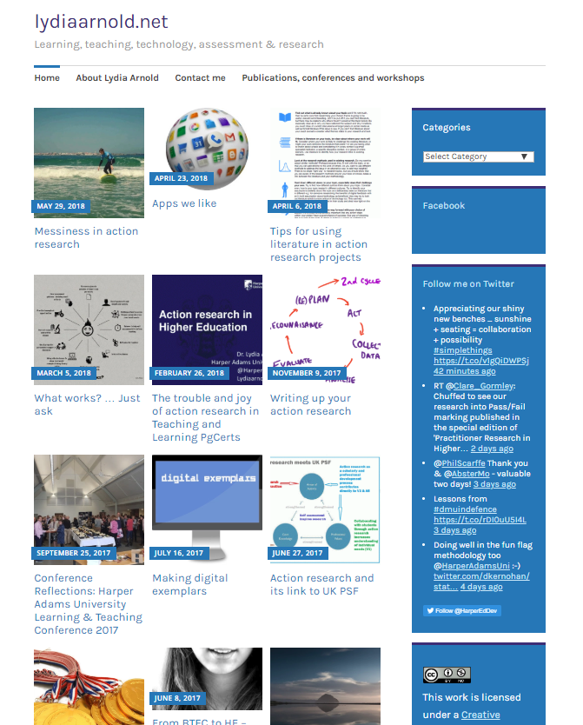

EdD
Ultraversity
PgCs companies and charities
PgC Teaching and Supporting Learning in HE
Supervised 37 projects to date
  Inclusive teaching
  Virtual field trips
  Marking standardisation
  Interactive teaching
  Playful learning
  Library engagement
  3D Lab Video
  Flipped classroom
Notes:
About me – Educational Developer @ HAU, previously Anglia Ruskin
Interests – assessment, feedback, research, technology, teaching excellence
Blogger
HEA Guide
Twitter
AR – degree, pg courses, online, now teaching and learning
Outside of all this … mostly managing teenagers, battling fitness and travel

Slide 3
What is action research …. and why might I want to do it?
How do I undertake action research?
What are the barriers, and how do I get past them?
What might action research actually look like?
How can it transform learning and teaching?
Notes:
Simplification
Literature was scary ….
Emancipation, transformative, participative etc.
Cut to the chase

Slide 4
Reaction to action research amongst lecturing staff
Notes:
These are the reactions – I normally get!

Slide 5


Action research is collaborative, emancipatory, reflexive and reflective, moral, change-oriented, radical, participatory, democratic, liberating, life-enhancing, practical and theoretical …
Notes:
Theproblem with AR literature …. And dialogue ….
For me it is abstract
For practitioners it can be unnecessarily complex – not patronising – but there is a lot of language that I found difficult
All of these things are true, but I think that there is a better way to make them clear.

Slide 6
What is action research?
About change and improvement (but make sure it’s daring and doing* not just complying)
No data?
Then it’s not research.
‘to systematically investigate one’s own teaching/learning facilitation practice with the dual aim of modifying practice and contributing to theoretical knowledge’ (Norton, 2009)
*Inspired by the title of the 2018 Collaborative Action Research Network Conference Title
Notes:
Simiple definition
Daring and doing – focus on how can we make powerpoints more inclusive, is less ‘daring’ than focusing on how we challenge and change hidden attitudes to ‘non-traditional’ students through an action to make the most of people’s talents through team based learning

Slide 7

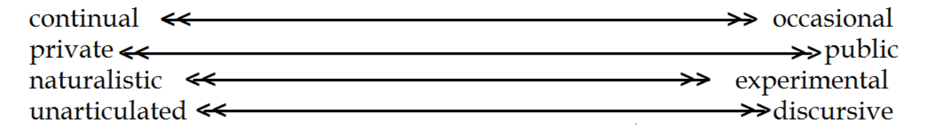
(Adapted from Tripp, 1995)
Notes:
Action research can feel like reflective practice
Family methods
Key differences highlighted
BIG difference is data

Slide 8
Why action research? Why not just research?
Provides a base of evidence for practice, in context.
Action! It can have a positive impact on current and future students.
It helps solve pressing and wicked issues; action research gives a framework to address the issues that trouble us.
  ‘Wouldn’t have tried this new type of teaching without my action research project’
Changing us, not just changing ‘that’.

Slide 9
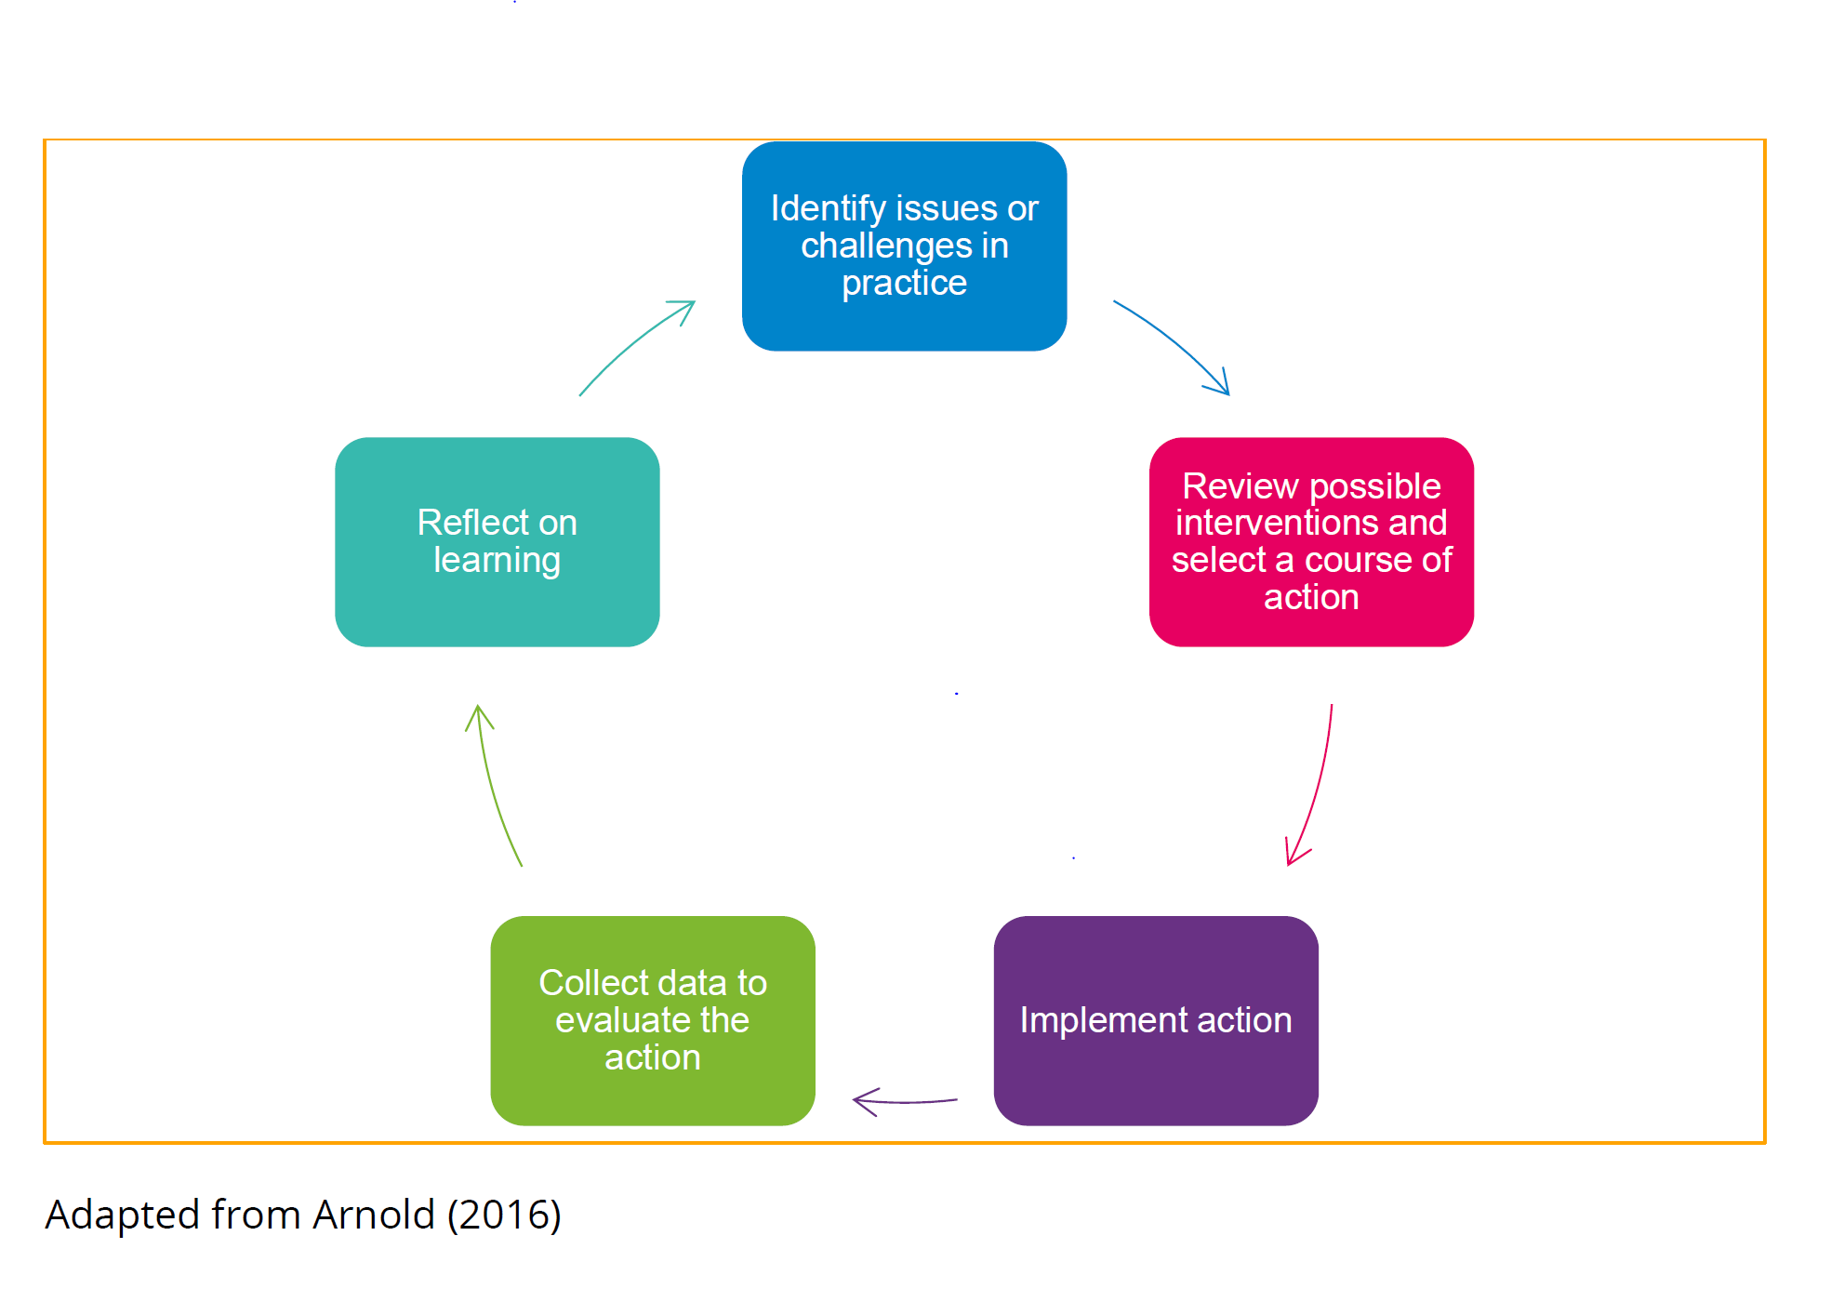
It’s OK to do part of a cycle
It’s OK to use student engagement as your action e.g. spaces, library projects
(Arnold & Norton, 2018)
Notes:
Often involves a cycle
Reconnaisance is key – by example … marking differences, grade variation, mark one section each or one batch each? After reading and exploring, standardisation stage was implemented to anticipate variation. Only twoc hoices, to a third option never before thought of.
Ethically – stops you doing something which could harm students.
Part of a cycle…..
Student engagement e.g. engagement on learning spaces, librarian interviews with staff to understand how they use and support reading, and how the librarty could better support?

Slide 10
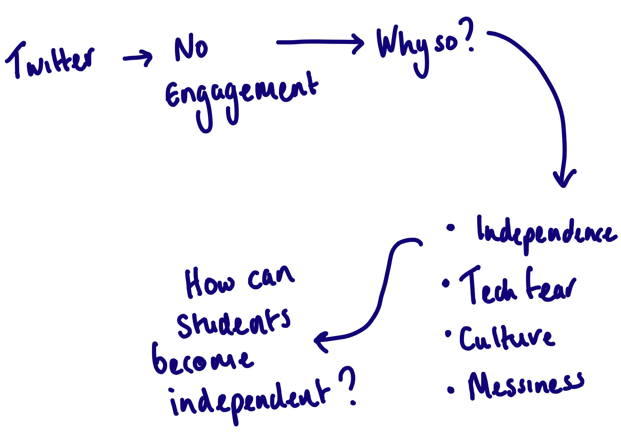

Behold, the messy cycle (Cook, 2009)

Slide 11
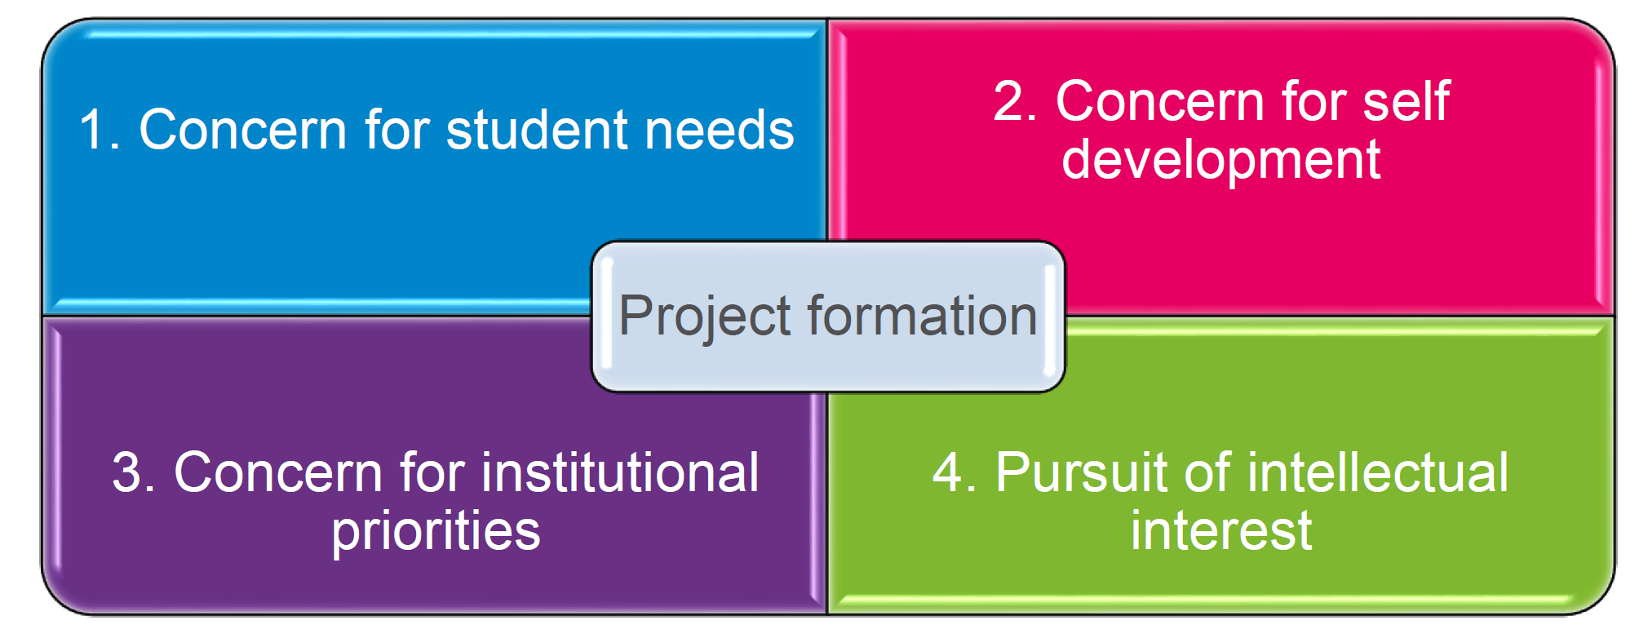
Identifying those wicked problems
UK PSF!
Arnold & Norton, 2018
Notes:
But don’t be driven by any single force!

Slide 12
Find your issue: What are your wicked problems?
Students are not engaging with independent study
Students don’t read!
I don’t think students are reading my feedback and acting on it
I am struggling to engage students who don’t have a science background
I’m tired of teaching the same experiment in ten repeat classes
Students are not developing critical thinking skills
I’m lagging behind on my use of technology in teaching
The international students in my class are separated from UK students in all we do.
“projects should not be thought of a straightforward initiatives but as opportunities to open doors and stimulate different approaches” (Norton, 2018, p.201)

Slide 13
What are your wicked problems? (MENTI.com)

Slide 14
Find your question ….
How can I …..
How do students ….
Bad questions
Why don’t students like digital feedback?
Notes:
Open questions
Focus on ‘I’ not ‘WE

Slide 15
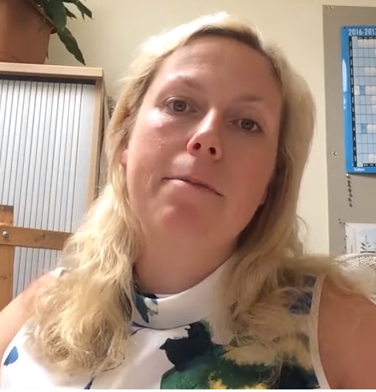
Example: Flipping the class (Lucy Crockford)
Engagement low; teaching at a higher level.
Read literature; discussed with colleagues; engaged with students.
Tried flipped to a limited extent, drawing on knowledge of effective practice.
Focus group to understand student experience.
Refine use for wider roll out but with lessons learnt about how flipped is best managed .

Slide 16
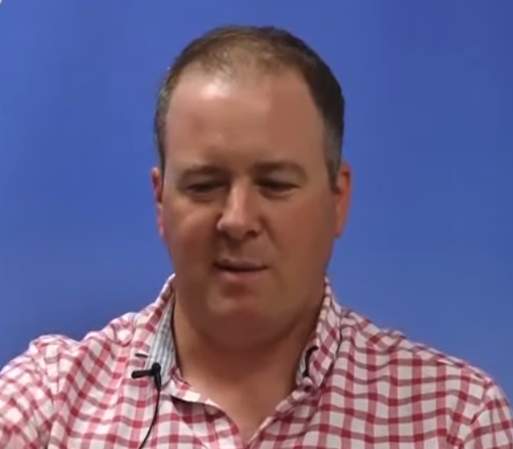
Example: Growing subject awareness (with Andrew Black)
Problems getting recognition of subject from school leavers
Explore reasons with initial data collection: Focus group and World café
Create a website to promote subject (games based, information, students as partners)
Gather data and assess impact
Where next?

Slide 17
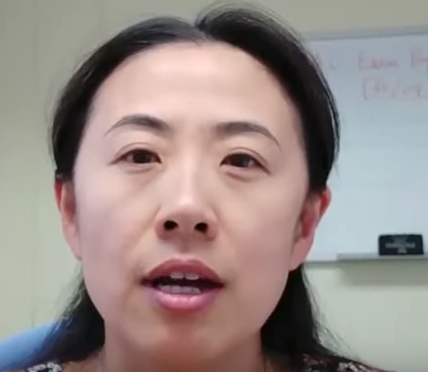
Example: Economics to non-economics majors (Hairong Mu)
Engagement low; achievement low for non-majors.
Read literature; discussed with colleagues; engaged with students.
Used quiz technology to create engagement opportunities.
Focus group and survey to understand experience.
Refine use for wider role out but with lessons learnt and enhancement e.g. monitoring interventions to identify at risk.

Slide 18

How big does my action need to be?
How much data do I need?
Surveys (not proof!)
Focus group
Interview
Observation
Tutor reflections
Documentary analysis
‘Speed write’
Happy sheets (Caution)
Post-it notes
Student reflections
Achievement data (Causal caution)
Experiments too! – which approach works better (x or y)

Slide 19
What are the barriers to engaging with action research? (MENTI.com)

Slide 20
Barriers
Time (day job)
  Make it fit; accept imperfection.
Language
  Don’t be put off; find resources that work for you.
Not committing/indecision
  Be systematic and stick with it!
Making sense of cycles
  Draw your cycles; collaborate and discuss; ‘surf’ the mess; spirit matters more.
Narrow, fixated plans
  Read and engage, seek ut different views
Questionnaire fatigue (coordinate)
  Institution wide coordination needed.
Self-belief
  Go for it!

Slide 21
Enablers
Others (learning sets, learning walks, mutual accountability)
Formal programmes
Examples/Reading
Start small – it always gets too big!
Advocates/sponsors
Conferences or dissemination commitments
Social media
Project lists (what matters?)
Shared space – locating problems together
What else

Slide 22
Action researchers mind-set
Be clear why your action or topic is important
Alarm bells should ring if you set out to change someone else or ever say ‘I want to show that ….’
Question yourself all the time (is this the best way? Did my implementation of the action cause this response? Does what I am learning fit with what I do and believe? e.g. International staff development
Be flexible (open to change your plan) e.g. Twitter use in students project
Open yourself to critique – invite others to comment and critique
Be ethical – it’s a mind set not a form!

Slide 23

Ethics vs. Ethical Mindset
Guilty knowledge
After the tape is off
Boundaries of student data
Inflicting an action
Boundaries of permission (how can a student really opt out)
Telling the truth vs disrepute (institutional public face)
Tackling the right issues (not the easy ones)
Representation: Whose voices can you hear in your study?

Slide 24
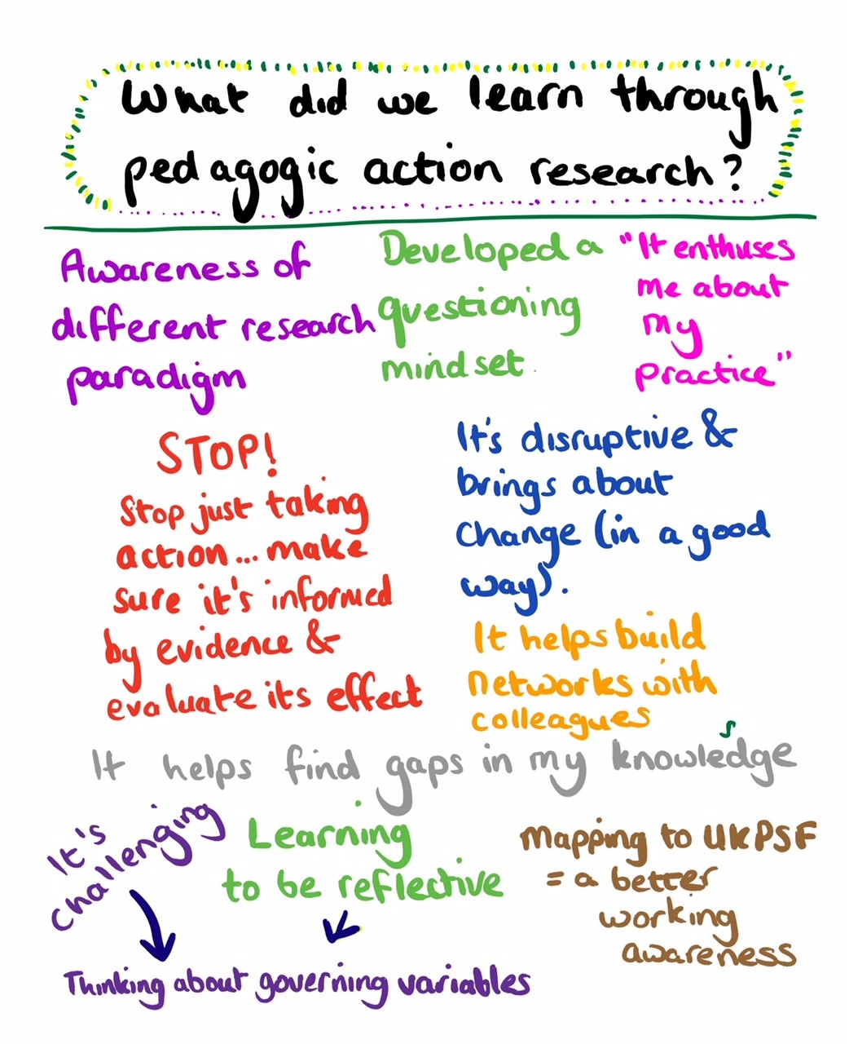
Impact

Slide 25
For my interviews I deliberately chose two academics who I had hardly spoken to previously and, as with all my interactions on the project, this proved fruitful in developing my relationship with them and raising my professional identity. I hope to build on this both informally by visiting the staff common room more frequently and formally by requesting occasional slots at departmental meetings.

Slide 26
The whole action research process has provided me with the opportunity to work and think like a student, exploring the three-way transaction between the student, teacher and the material being studied (Entwistle, 2015); something I have not done for many years. This is hugely beneficial as it gives me another perspective as a teaching practitioner; an insight into how it feels to undertake research, and to cope with the uncertainties and ‘mess’ that results.

Slide 27
Whilst conducting my action research project, I have realised how important it is that I consider the evidence and literature behind my teaching practices, and that I do not just follow certain teaching practices because it is what other colleagues in my department do. It has enabled me to develop more of a questioning mind-set.

Slide 28
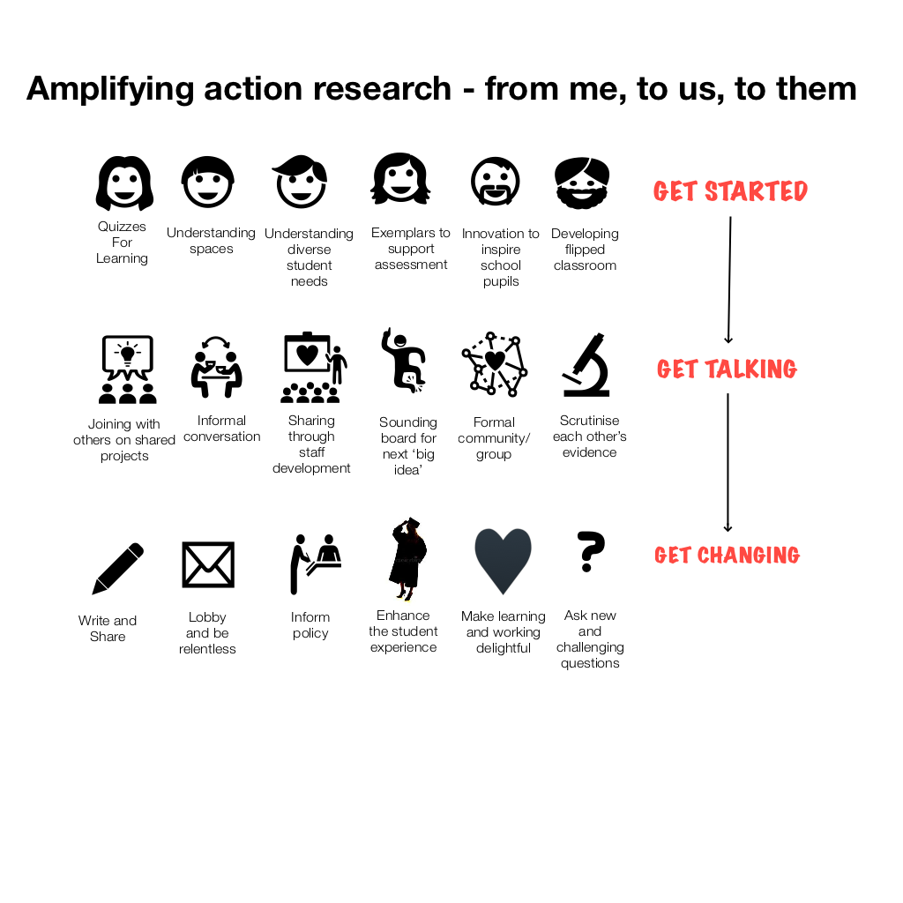

Slide 29
Change ripples
Spaces (policy and committee)
Quiz-mania
‘our kind of’ flipped
Exemplars – optimising assessment
Working with international colleagues

Slide 30
Action research is ….
Accessible
A broad church
Better together
About enhancement (a better deal)
Not scary, but it’s always messy
Part of routine work
A powerful trigger for change – me, us and them
Valuable to individual careers
Can help make teaching more effective and more delightful
Good fun!

Slide 31

Recommendations

Slide 32
References:
Arnold, L. & Norton, L. 2018a. Action Research: practice guide. https://www.heacademy.ac.uk/knowledge-hub/action-research-practice-guideHEA: York.
Cook, T. (2009) The purpose of mess in action research: building rigour though a messy turn. Educational Action Research. 17 (2), 277–91.
McNiff, J. (2016) You and your action research project (4th Ed.). Abingdon: Routledge
Tripp, D. (1995) e-Report 017: action Inquiry, action research [Internet]. University of Sydney. Available from: https://www.researchgate.net/publication/305619003_Tripp-_Action_InquiryAction_Researchpdf [Accessed 1 December 2017].
Norton, L (2018) Evaluating the effectiveness of transition issues. In Matheson, R, Tangney, S. and Sutcliffe, M. (eds) Transition in, through, and out of higher education. Routledge.
With thanks to colleagues cited for allowing me to share their research examples, and to Carl Kennard for graphics help.

