Slide 1
Action Research Workshop
July 2018 – Newcastle College
Dr. Lydia Arnold PFHEA
@HarperEdDev
lydiaarnold.net
larnold@harper-adams.ac.uk

Slide 2
Outcomes:
Plan an action research project to establish areas of interest.
Generate questions about the process of action research.
-------------------------------------------------------------------------
In 50 minutes we will plan the outline of an action research project!

Slide 3
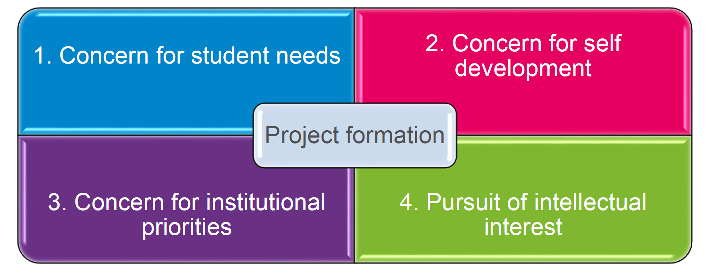
Step 1. Wicked problems
Reflect on the issues that concern you.
What troubles you in YOUR practice? What do YOU want to improve?
Form groups – Learning Sets can help you to dig deeper on your issue; the provide an interested sounding board that can motivate and steer your project.

Slide 4
Step 2: What is your question.
How can I develop ….?
How can I improve ….?
How can I better understand ….?
Remember good action research questions allow space for unexpected answers and exploration.
Avoid questions that drive for proof or closed ‘yes/no’ answers.

Slide 5
Step 3: Reconnaissance
To find a way forward what do you need to do:
Talk to ….
Read about ….
Collect data on ….
Here you may already have an idea of what you will ‘do’ but it is essential that you check your action will have a good chance of success.
Identify whether literature can shed light on your problem, but be aware of context differences e.g. flipped is different in Physical Education programme compared to an Engineering course.
Consider using students t o sense check your possible ways forward.

Slide 6
Step 4: Tentative action
Identify the possible action that would help you to answer your question. This should not be fixed, but remains tentative until after reconnaissance and beyond. Never be afraid to change course if the evidence suggests that you should.
Check your action is manageable and likely to succeed (in good faith).
Limit your action to specific situations e.g. specific classes or groups.

Slide 7
Step 5: Data collection
How will you assess your action? Try to avoid outcomes such as ‘yes it worked’ or ‘no it didn’t’ – look for the nuances, to make new understanding.
Look at your action in deeper ways: (what methods will help you)
How well did it work?
Was it effective for students or colleagues from different backgrounds and with different views and values?
What was the impact on different stakeholders (e.g. students, colleague, ‘me’, resource managers, professional services colleagues)?
How did my implementation vary from those in literature?
Did the action work better in some circumstances compared to others?
Consider the methods that others have used (can you add to existing research by using similar or very different methods).
Consider your development of research skills with ease and comfort with some methods over others.

Slide 8
Step 6: Ethics
How will you ensure your students (or other participants) can really consent and have a right to not participate?
How eill you hear different voices?
Is there potential for management conflict? How might you manage this?
Is there any emotional risk/exposure that you may need to prepare to handle?
If you have preconceived views, how do you ensure that you don’t fashion your research?
What dilemmas might you encounter?
How will you navigate the ethical terrain? (who will be your guide?)

Slide 9
Step 7 Dissemination
Who cares about your research?
What are you ready for? (blogging, trainer journal, university publication or major journal)
Can you disseminate along the way? (i.e. not just at the end of the project)
How will you manage the managers, if they don’t like your findings?
One off university wide publication? (could you get together and make this happen?)
How will you amplify your learning (e.g. learning set, community group, coffee club, formal forums, conferences)?
How will you motivate to get the job done!

Slide 10
As a group – choose the project that inspires you most and share a summary back to the group.

Slide 11
Go forth, be daring, challenging, changing.
And don’t forget to share it!

