Slide 1
Seeding creativity: Putting PebblePad at the heart of Academic Development
Dr Lydia Arnold
PFHEA NTF CMALT

Slide 2

Small (perfectly formed)
Specialist
Sustainable
Seed change

Slide 3
PgC
CPD Internal
Written Submission
Research & development
Oral discussion
Community
3 ways to Fellowship

Slide 4
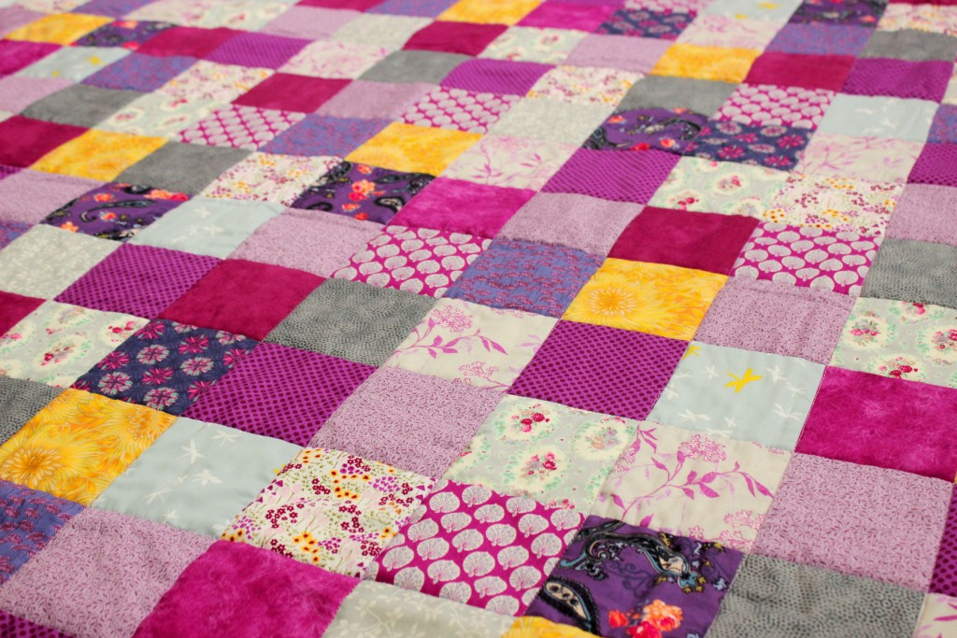

Slide 5
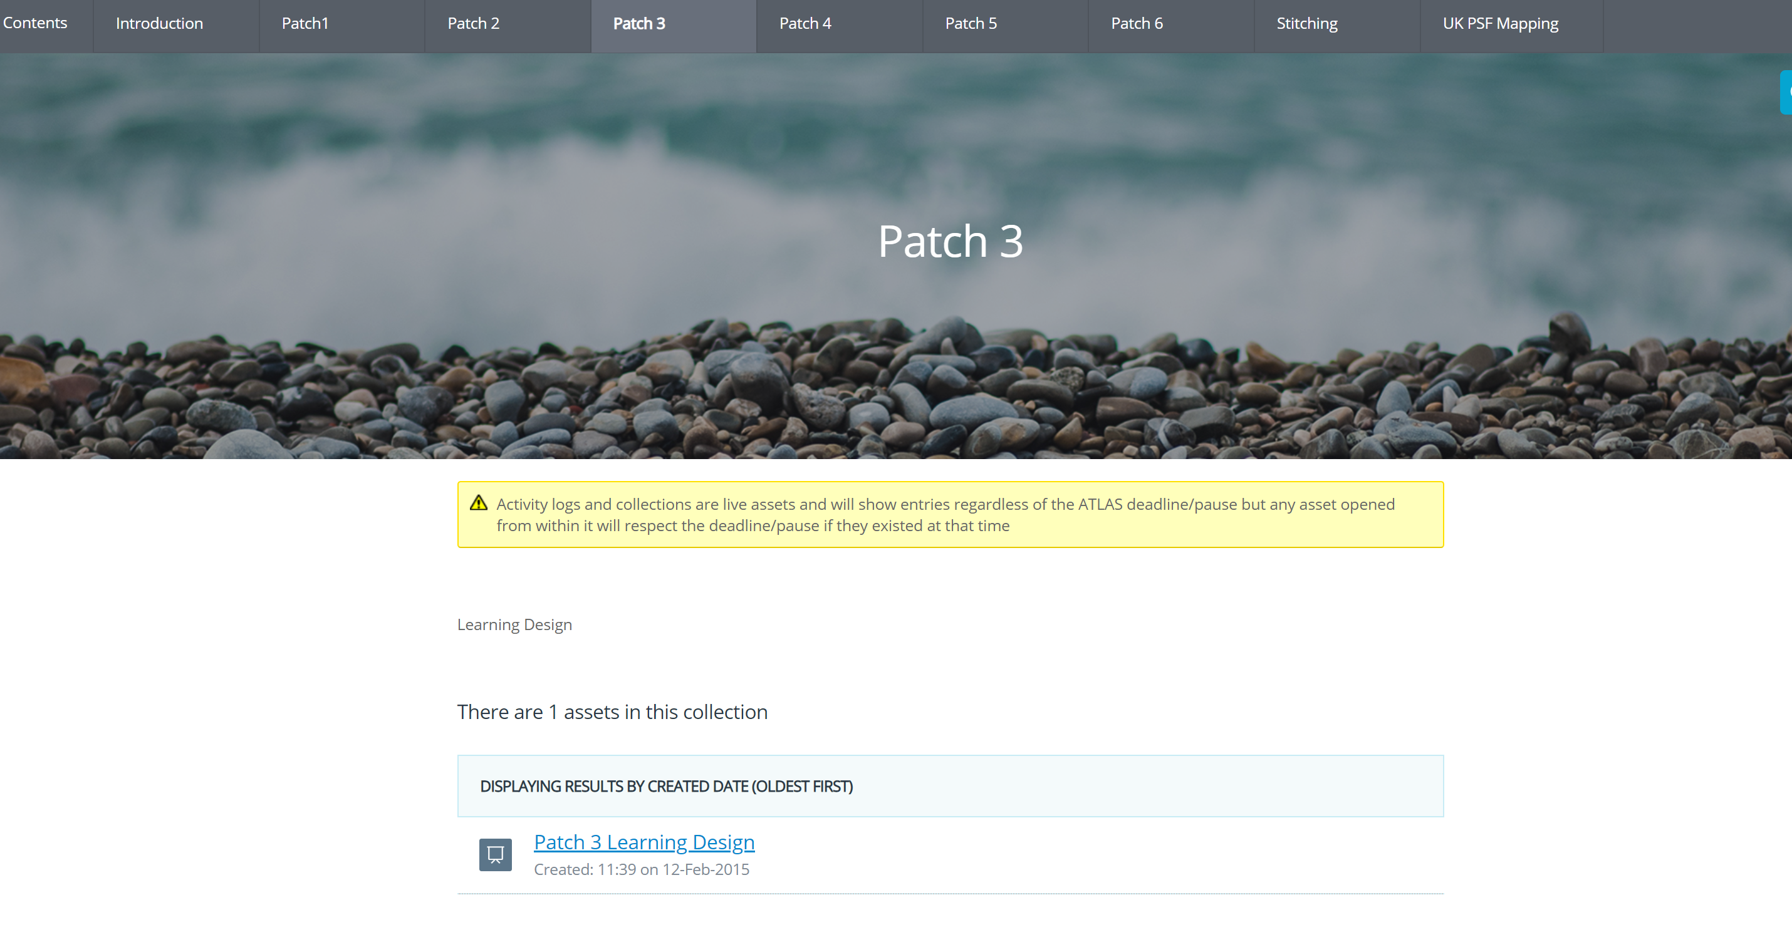
PgC Looking Back
Disproportionate effort! Text and pointlessness.
A glorified repository?

Slide 6

The epiphany
Staff created exemplars – walking the walk
More empathy with student issues
More able to support technical differences
Setting the initial expectations

Slide 7
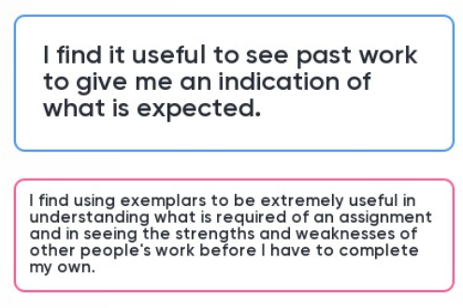
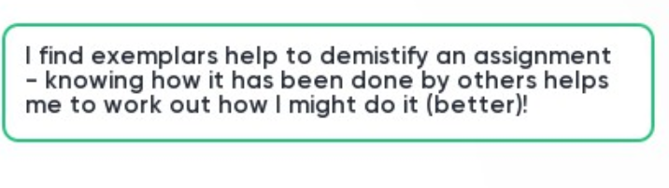
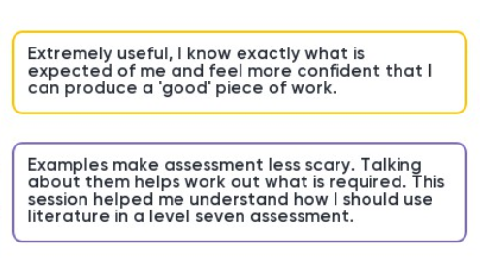

Slide 8
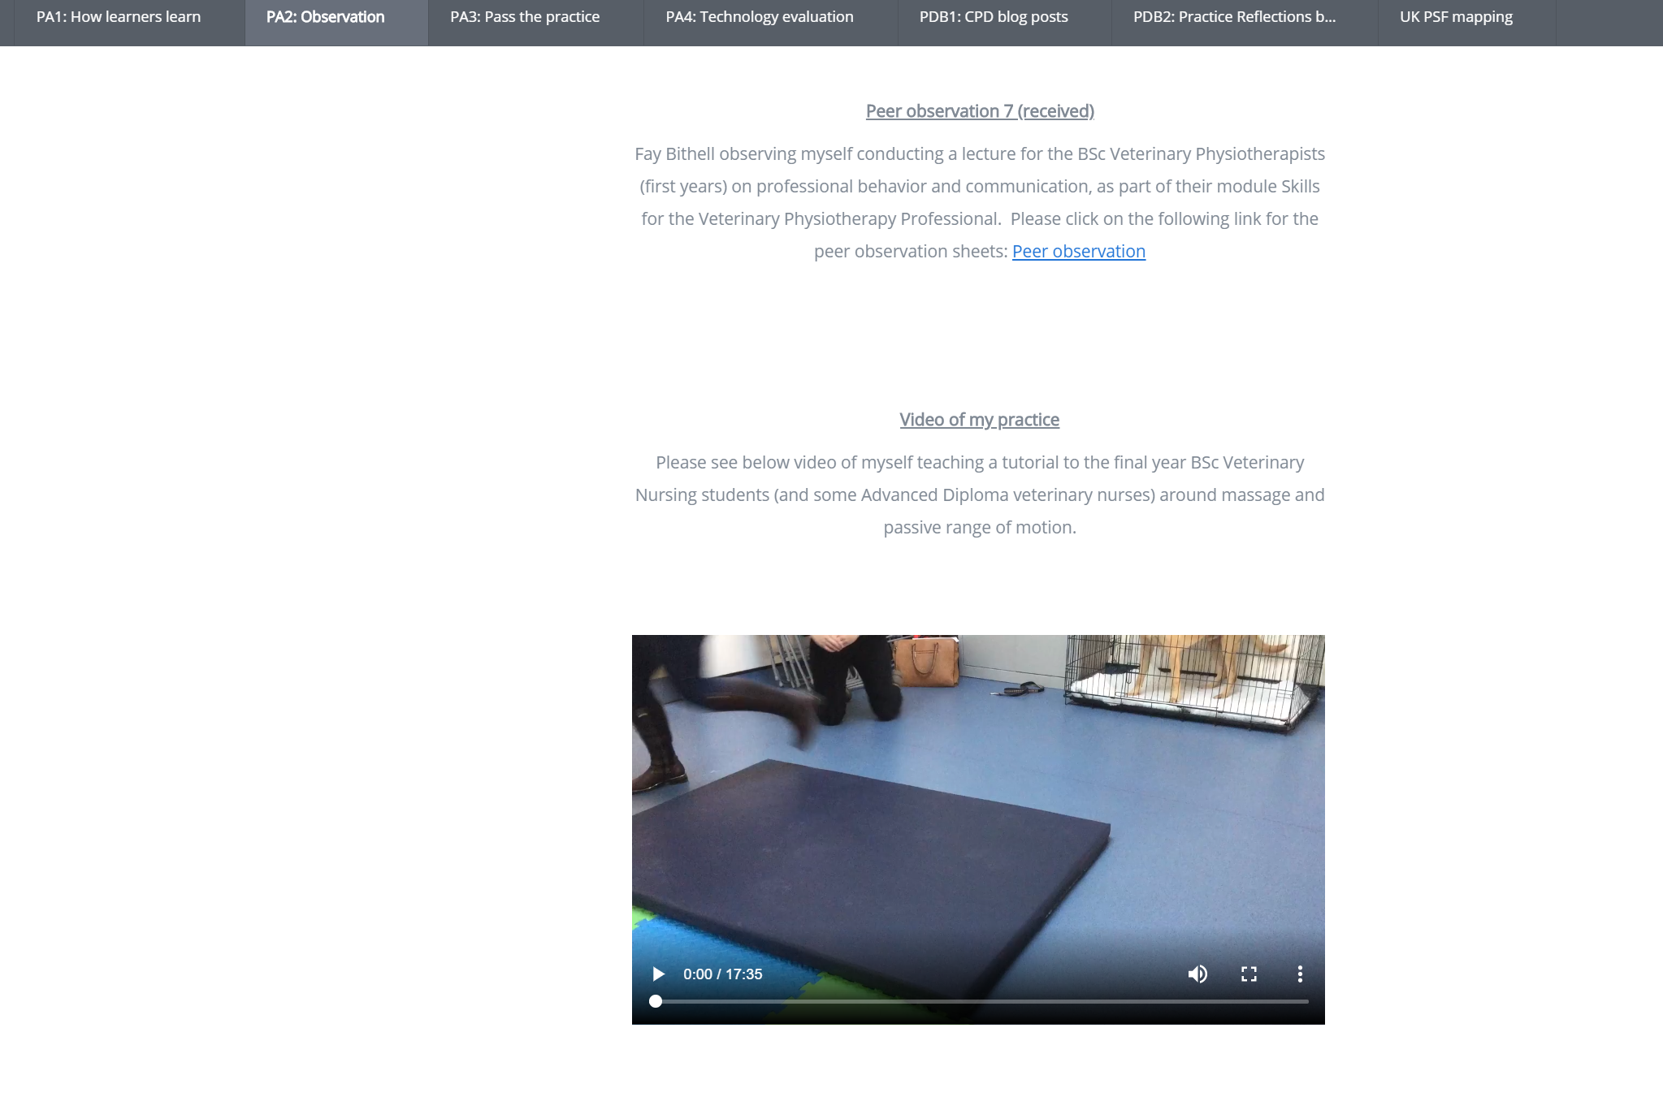
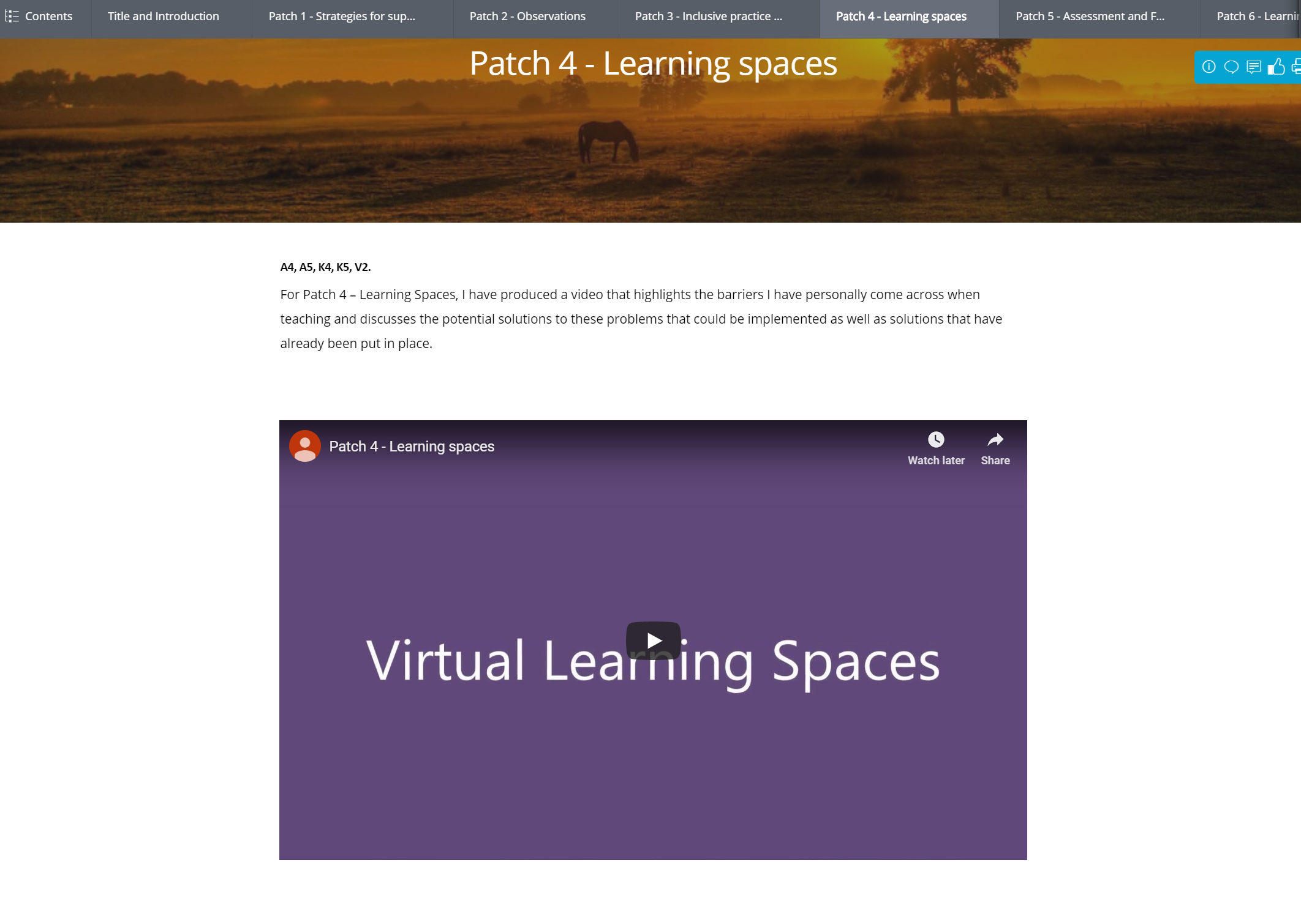
Design it in!
Teaching observations by video (Design this in to add value )
Personalisation by discipline
Video creation

Slide 9
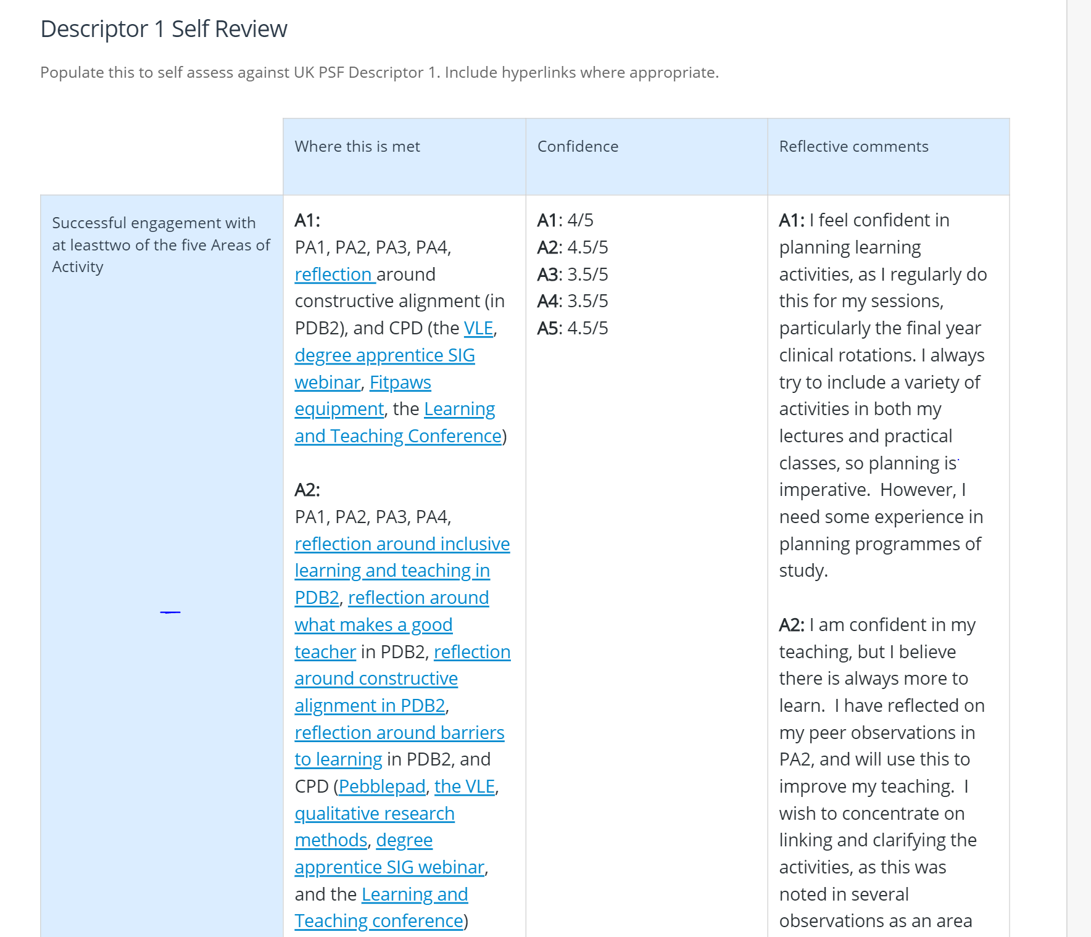
Mapping templates
Hyperlinks and tags

Slide 10
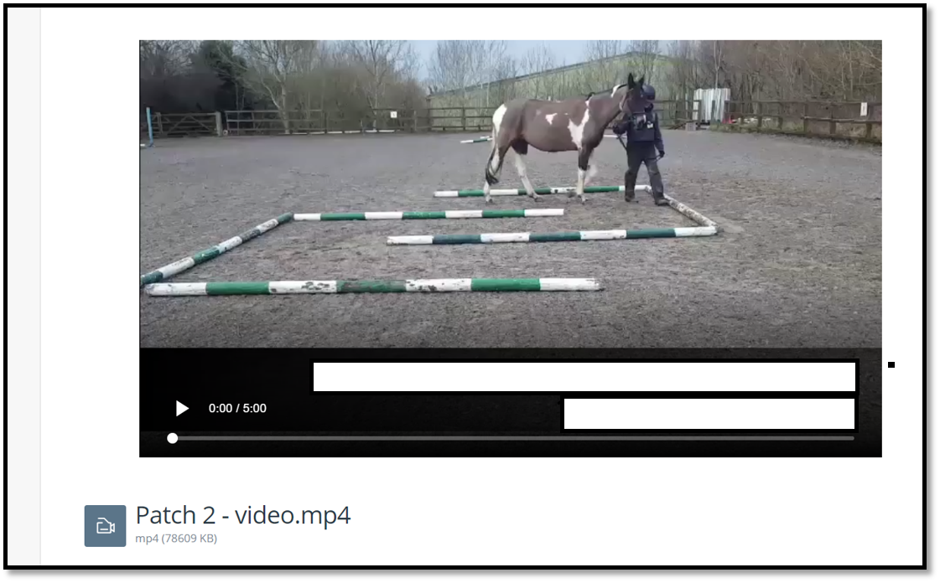
Ripples …
Students colleagues go on to …
Take risks
Use media
Accept non-typical formats
Develop digital skills to use in practice

Slide 11
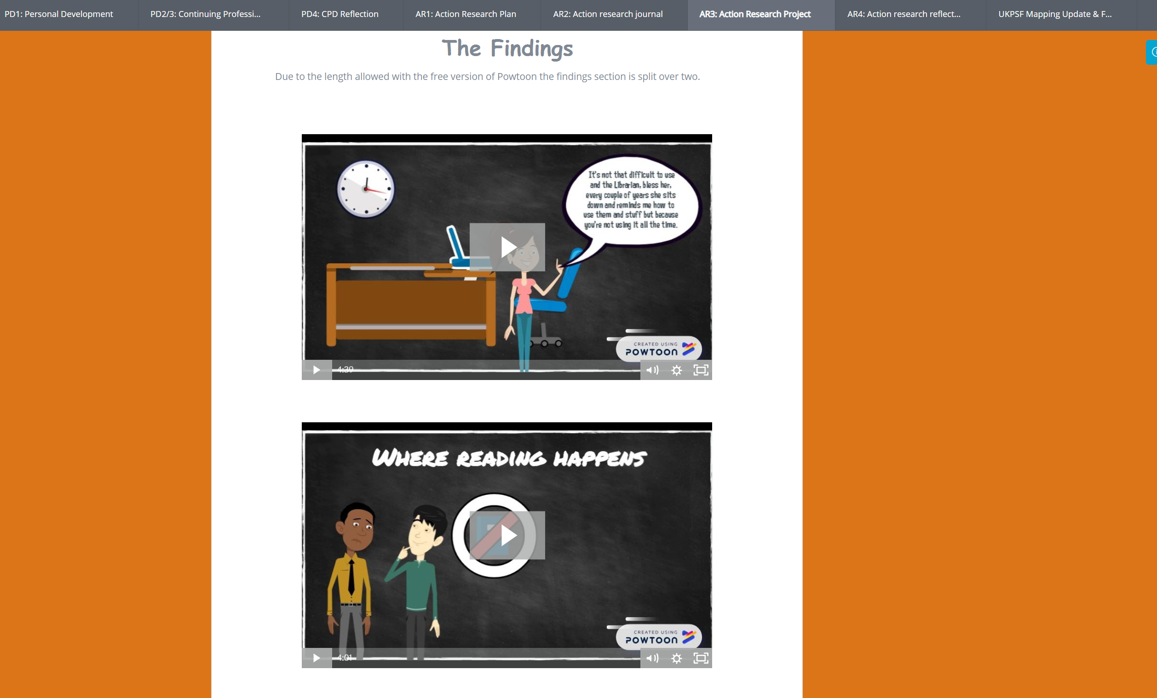

Slide 12
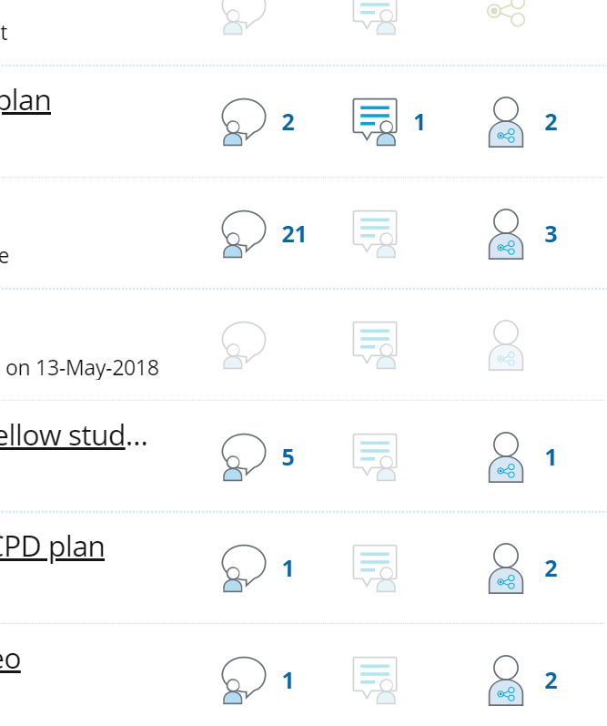
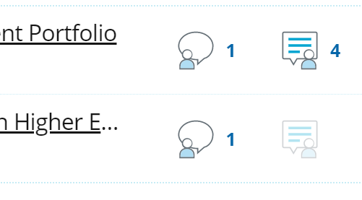
Sometimes, maybe
Design and reward

Slide 13
UK PSF
Reaccreditation
Extend digital skills
Template overload
AFHEA Written
FHEA Written
SFHEA Written
AFHEA Discussion
FHEA Discussion
SFHEA Discussion

Slide 14
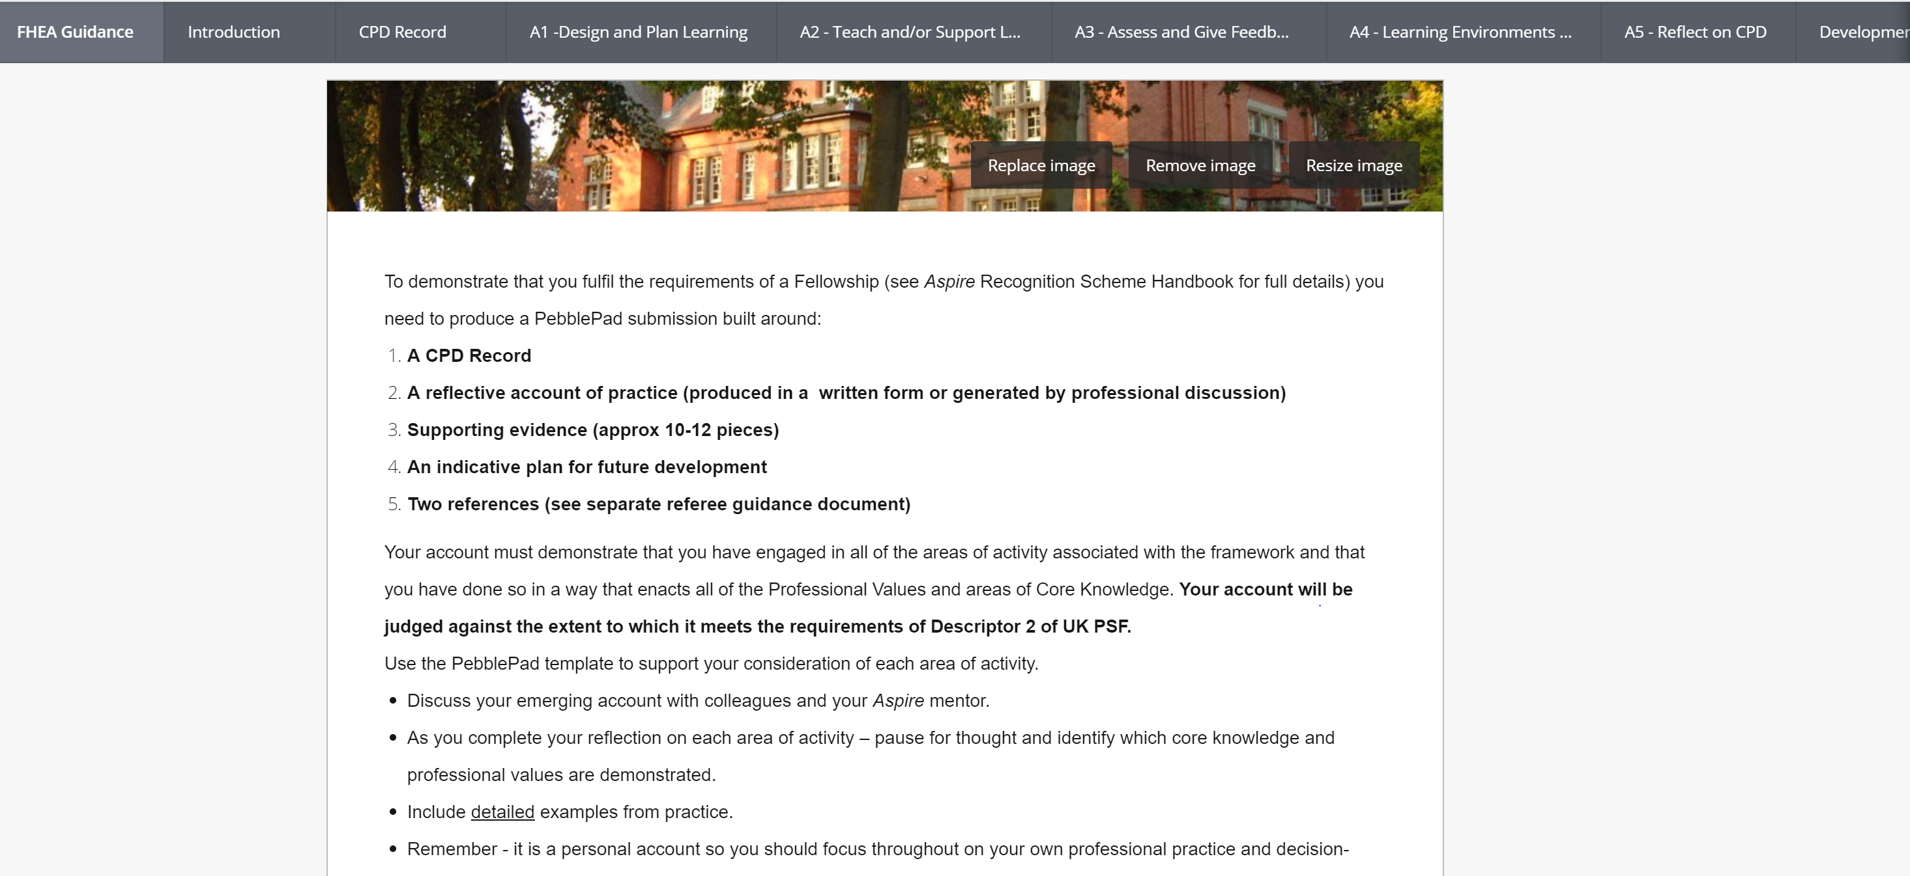
6 => 3

Slide 15
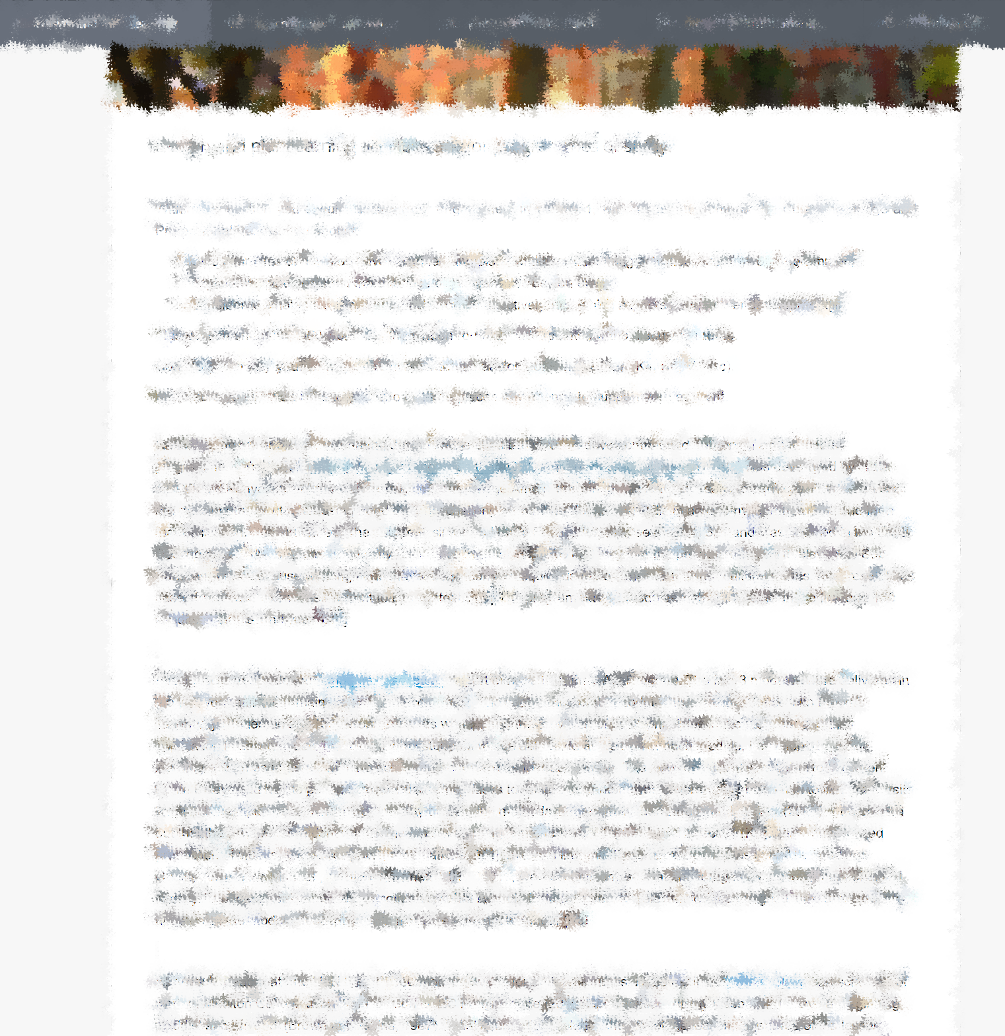
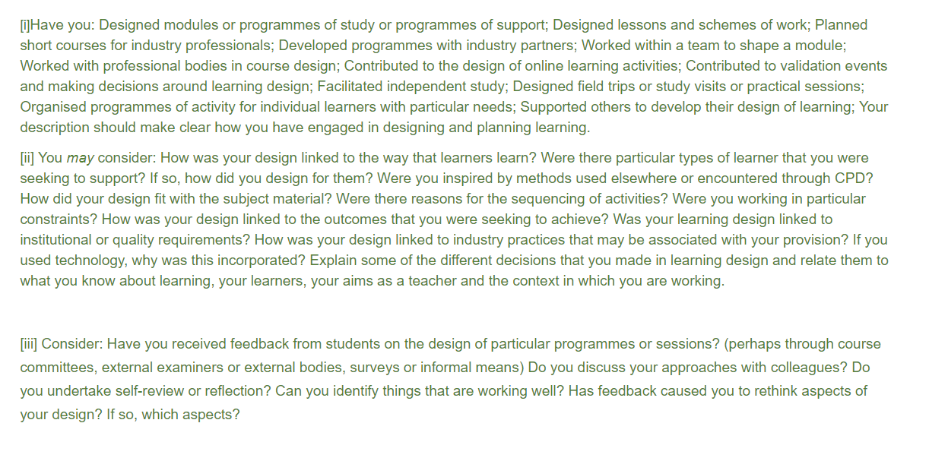
Evidence (deliberately blurred for wider sharing)
Specific co-located guidance

Slide 16
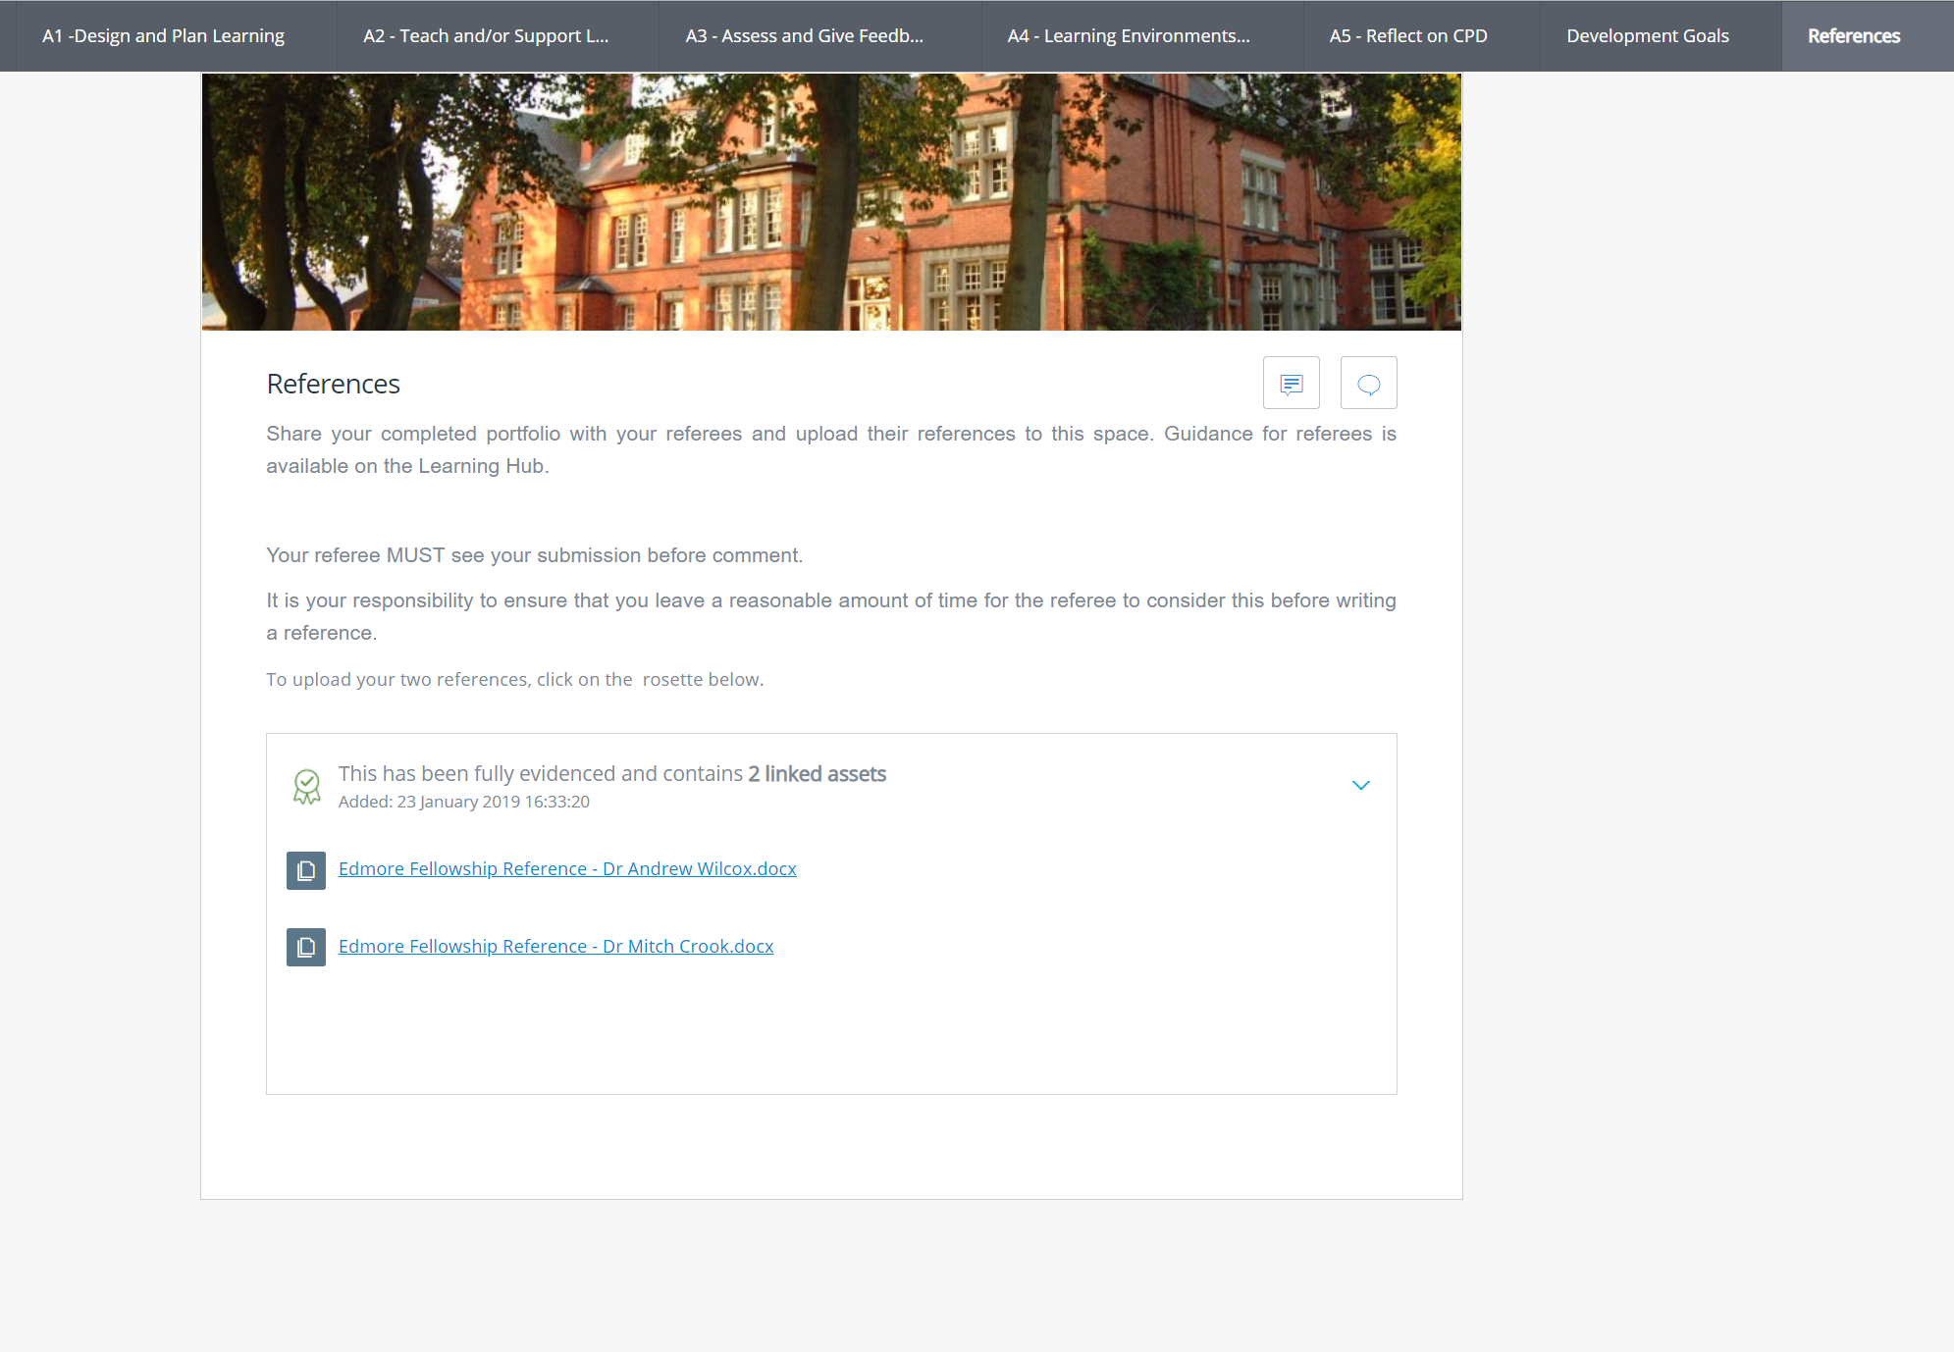
Referees and an extra ripple

Slide 17
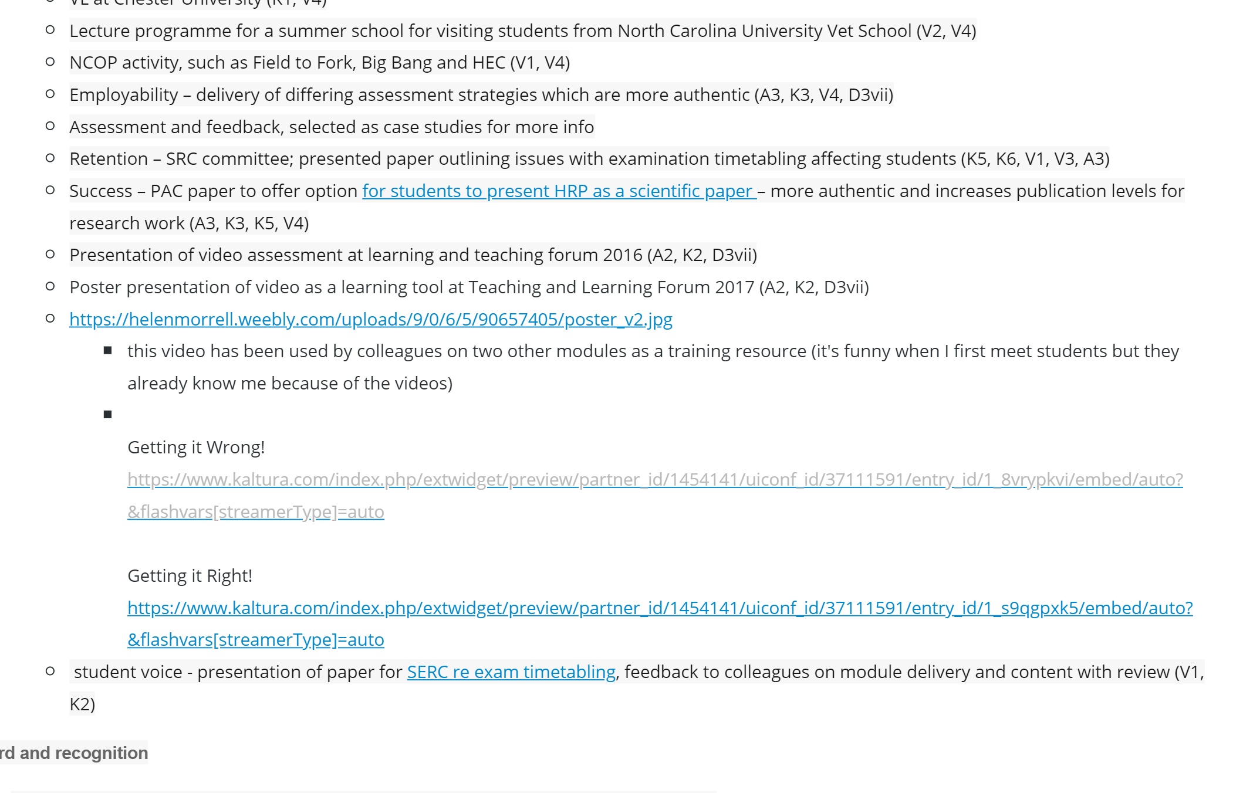
Notes Format + Evidence (for the discussion route)

Slide 18
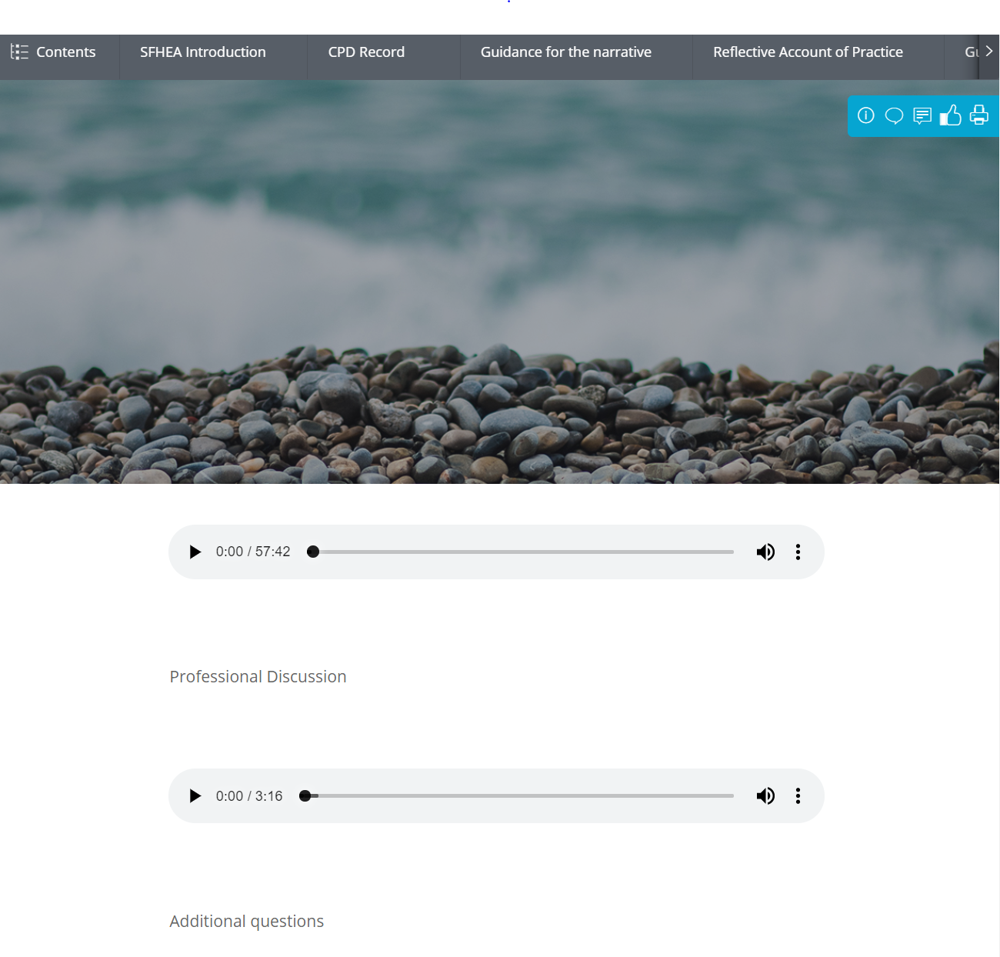
The optional audio
upload

Slide 19
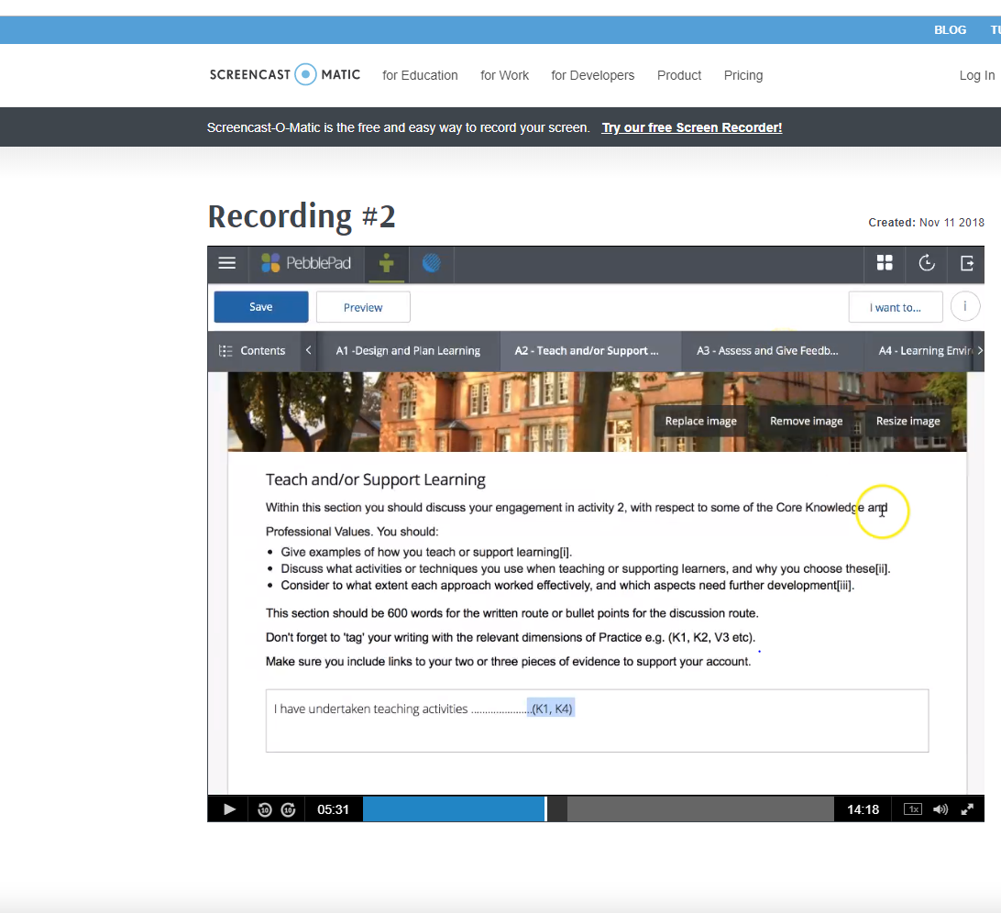
Benefits & Challenges
Choice
Ease of management
Engagement of assessors
No refusers (a few sighers)
Time lapse

Slide 20



Language metaphors

Slide 21

Where now?

