Slide 1
What does an inclusive curriculum look like in the 21th Century?
Professor Lydia Arnold PFHEA NTF
Associate PVC Learning, Teaching and Digital, Harper Adams University
@LydiaJArnold
lydiaarnold.net
Images from Canva or original unless otherwise stated.

Slide 2

Spoiler alert
A question of three parts
Inclusive
Future
Curriculum

Slide 3


Who am I?
Background as a developer
Key interests: Authentic assessment & action research … and now … organisational change
Blogger: lydiaarnold.net, Twitter
Keele Alumnus (and Keele parent!); Staffordshire Proud!
Roles that are relevant to this (my positionality): Associate PVC, Lecturer, Colleague, Mother (Final year and first year)
Leading Harper Forward Curriculum Project

Slide 4

This session – a Journey
What do the terms mean
Why they are problematic
Let’s be pragmatic – what can we do
Pledges for implementation

Slide 5
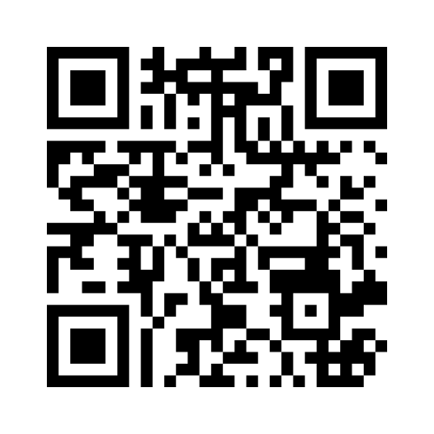
Menti
What does the term ‘inclusive’ mean?
What does the term ‘curriculum’ mean?
Menti.com enter code 28 16 11 5

Slide 6
Terminology: ‘Curriculum’
The hidden curriculum exists of values, norms, and beliefs, amongst others, that are not documented or part of the official teaching, but that students are exposed to in the classroom (Uleanya, 2022).
Content
Methods of pedagogy
Hidden curriculum
Connected curriculum
Finite – a set of compromises
  Example Harper Forward
Personalised
Reflecting University mission
An image of societal trends and priorities
Professional requirements
A product of institutional resource and expertise
Messy and multi-layered
Some understand the curriculum as incorporating not only the knowledge it is hoped that students will acquire, but knowledge of pedagogy and how curricular content is to be imparted. This includes the activities and tasks devised by teachers—and might also include arrangements for assessment, although others see assessment as a separate concern (Scott 2001 cited in Stentiford & Koutsouris, 2022).

Slide 7
Terminology: ‘Inclusive’
Historically – originally gender and disability (Smucker, 2022)
Broader protected characteristics e.g. ages, sexuality
Broadening – points of identity e.g. caring responsibilities, first in family to HE

Slide 8
Thomas and May, 2010
Educational (entry qualifications, prior schooling, professional experience)
Dispositional (self-esteem, confidence, maturity, interests, beliefs)
Circumstantial (disability, geography, socio-economic grouping, urban/rural)
Cultural (language, country of origin, cultural capital, family responsibility)
I don’t fully agree with all of Thomas and May’s groupings!
DO we need a characteristics element e.g. age, sex, gender, sexuality, ethnicity element?
Identify some of the points of difference in YOUR students?
How might this impact their learning experience?

Slide 9

Why is inclusivity such a focus in curriculum? (See Steniford and Koutsouris (2022))
Global North – why so?
Government driver (50% school leavers in to HE?)
Metrics and accountability
Ethical perspective
Performativity rationale
Internationalisation
Proliferated by ‘bodies’ – HEFCE, HEA (now Advance HE)
Any other reasons?
A hidden curriculum – a hidden staff view? Maybe?

Slide 10
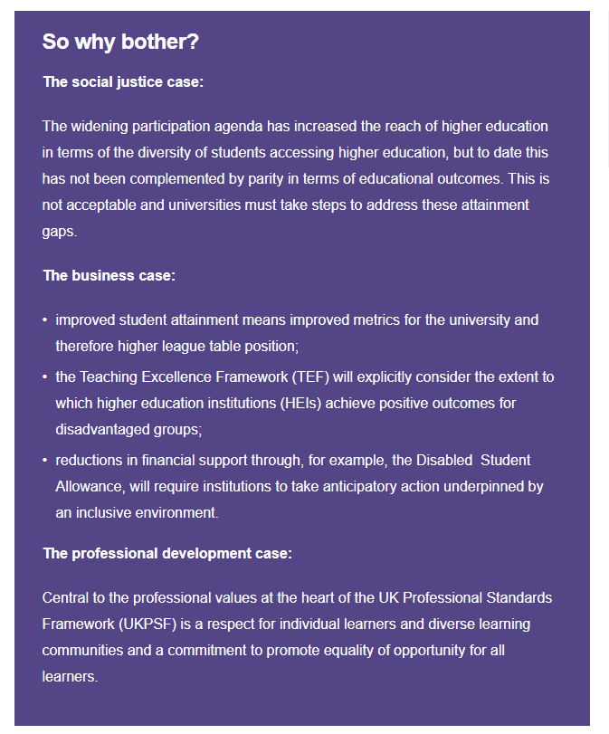
“The case” – Advance HE

Slide 11
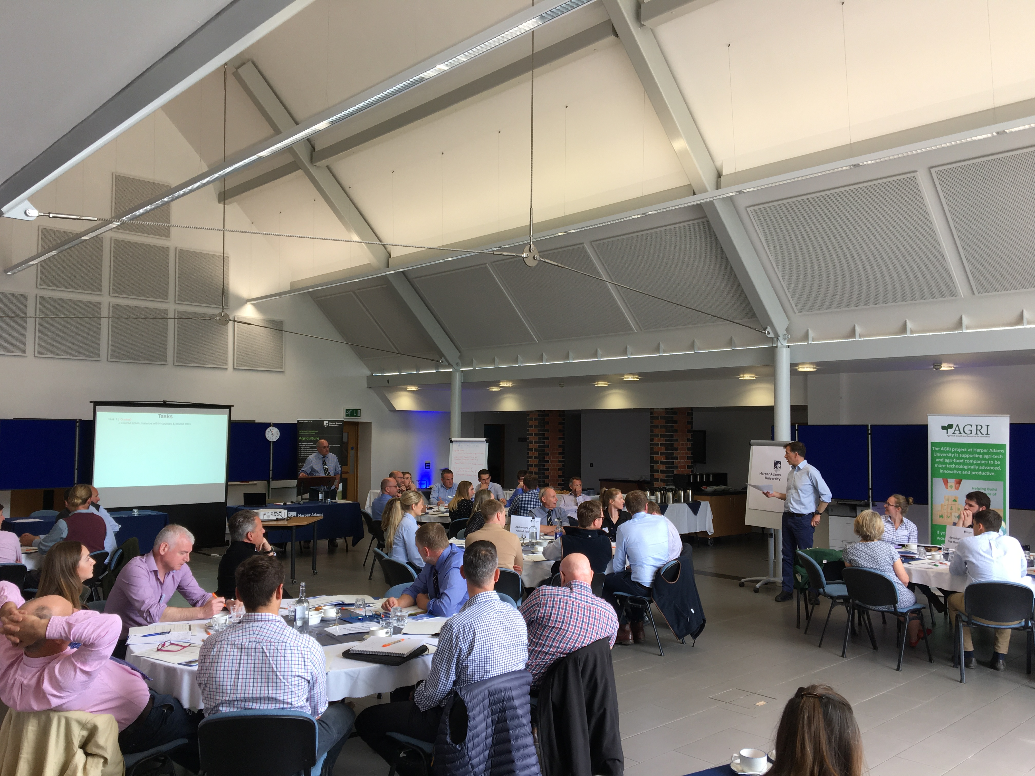
An inclusive-21st Century curriculum must be well researched curriculum
Schools
Students
Charities in the subject area
Personal contact
Database searches
Events
International networks
Look beyond current demographic voices

Slide 12
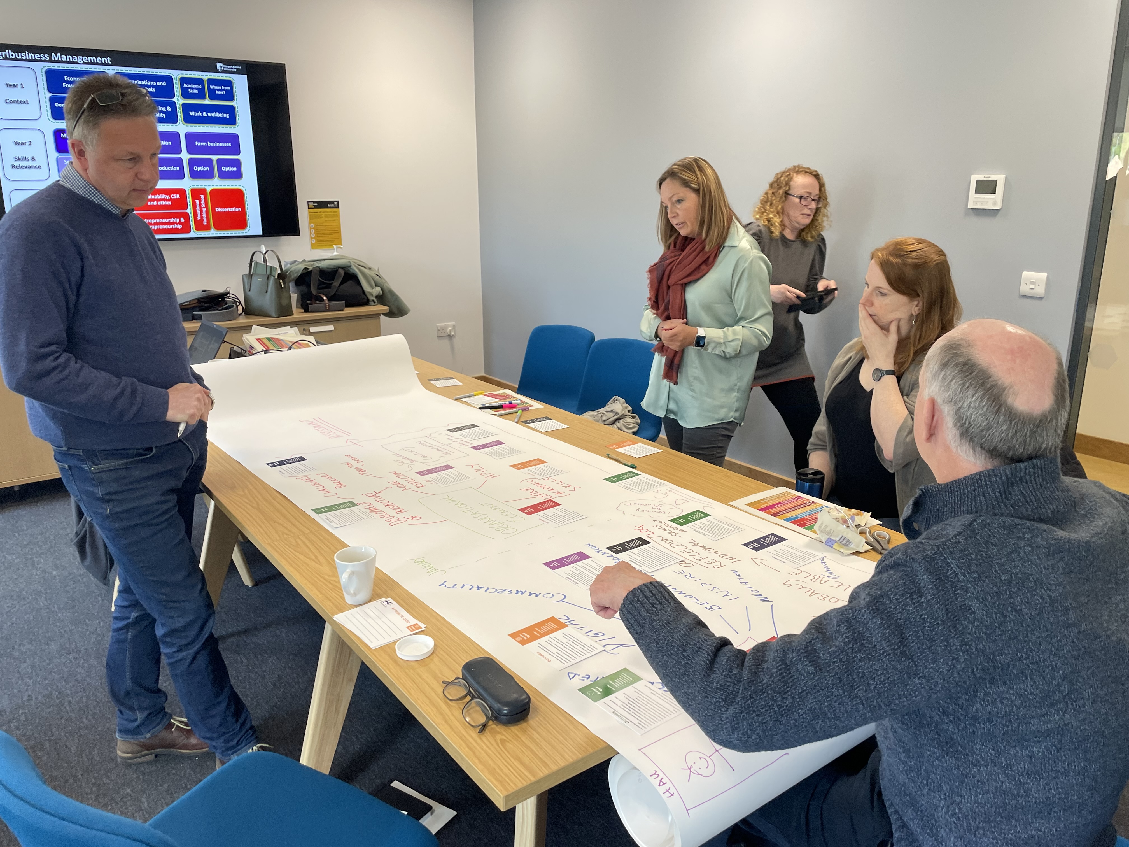
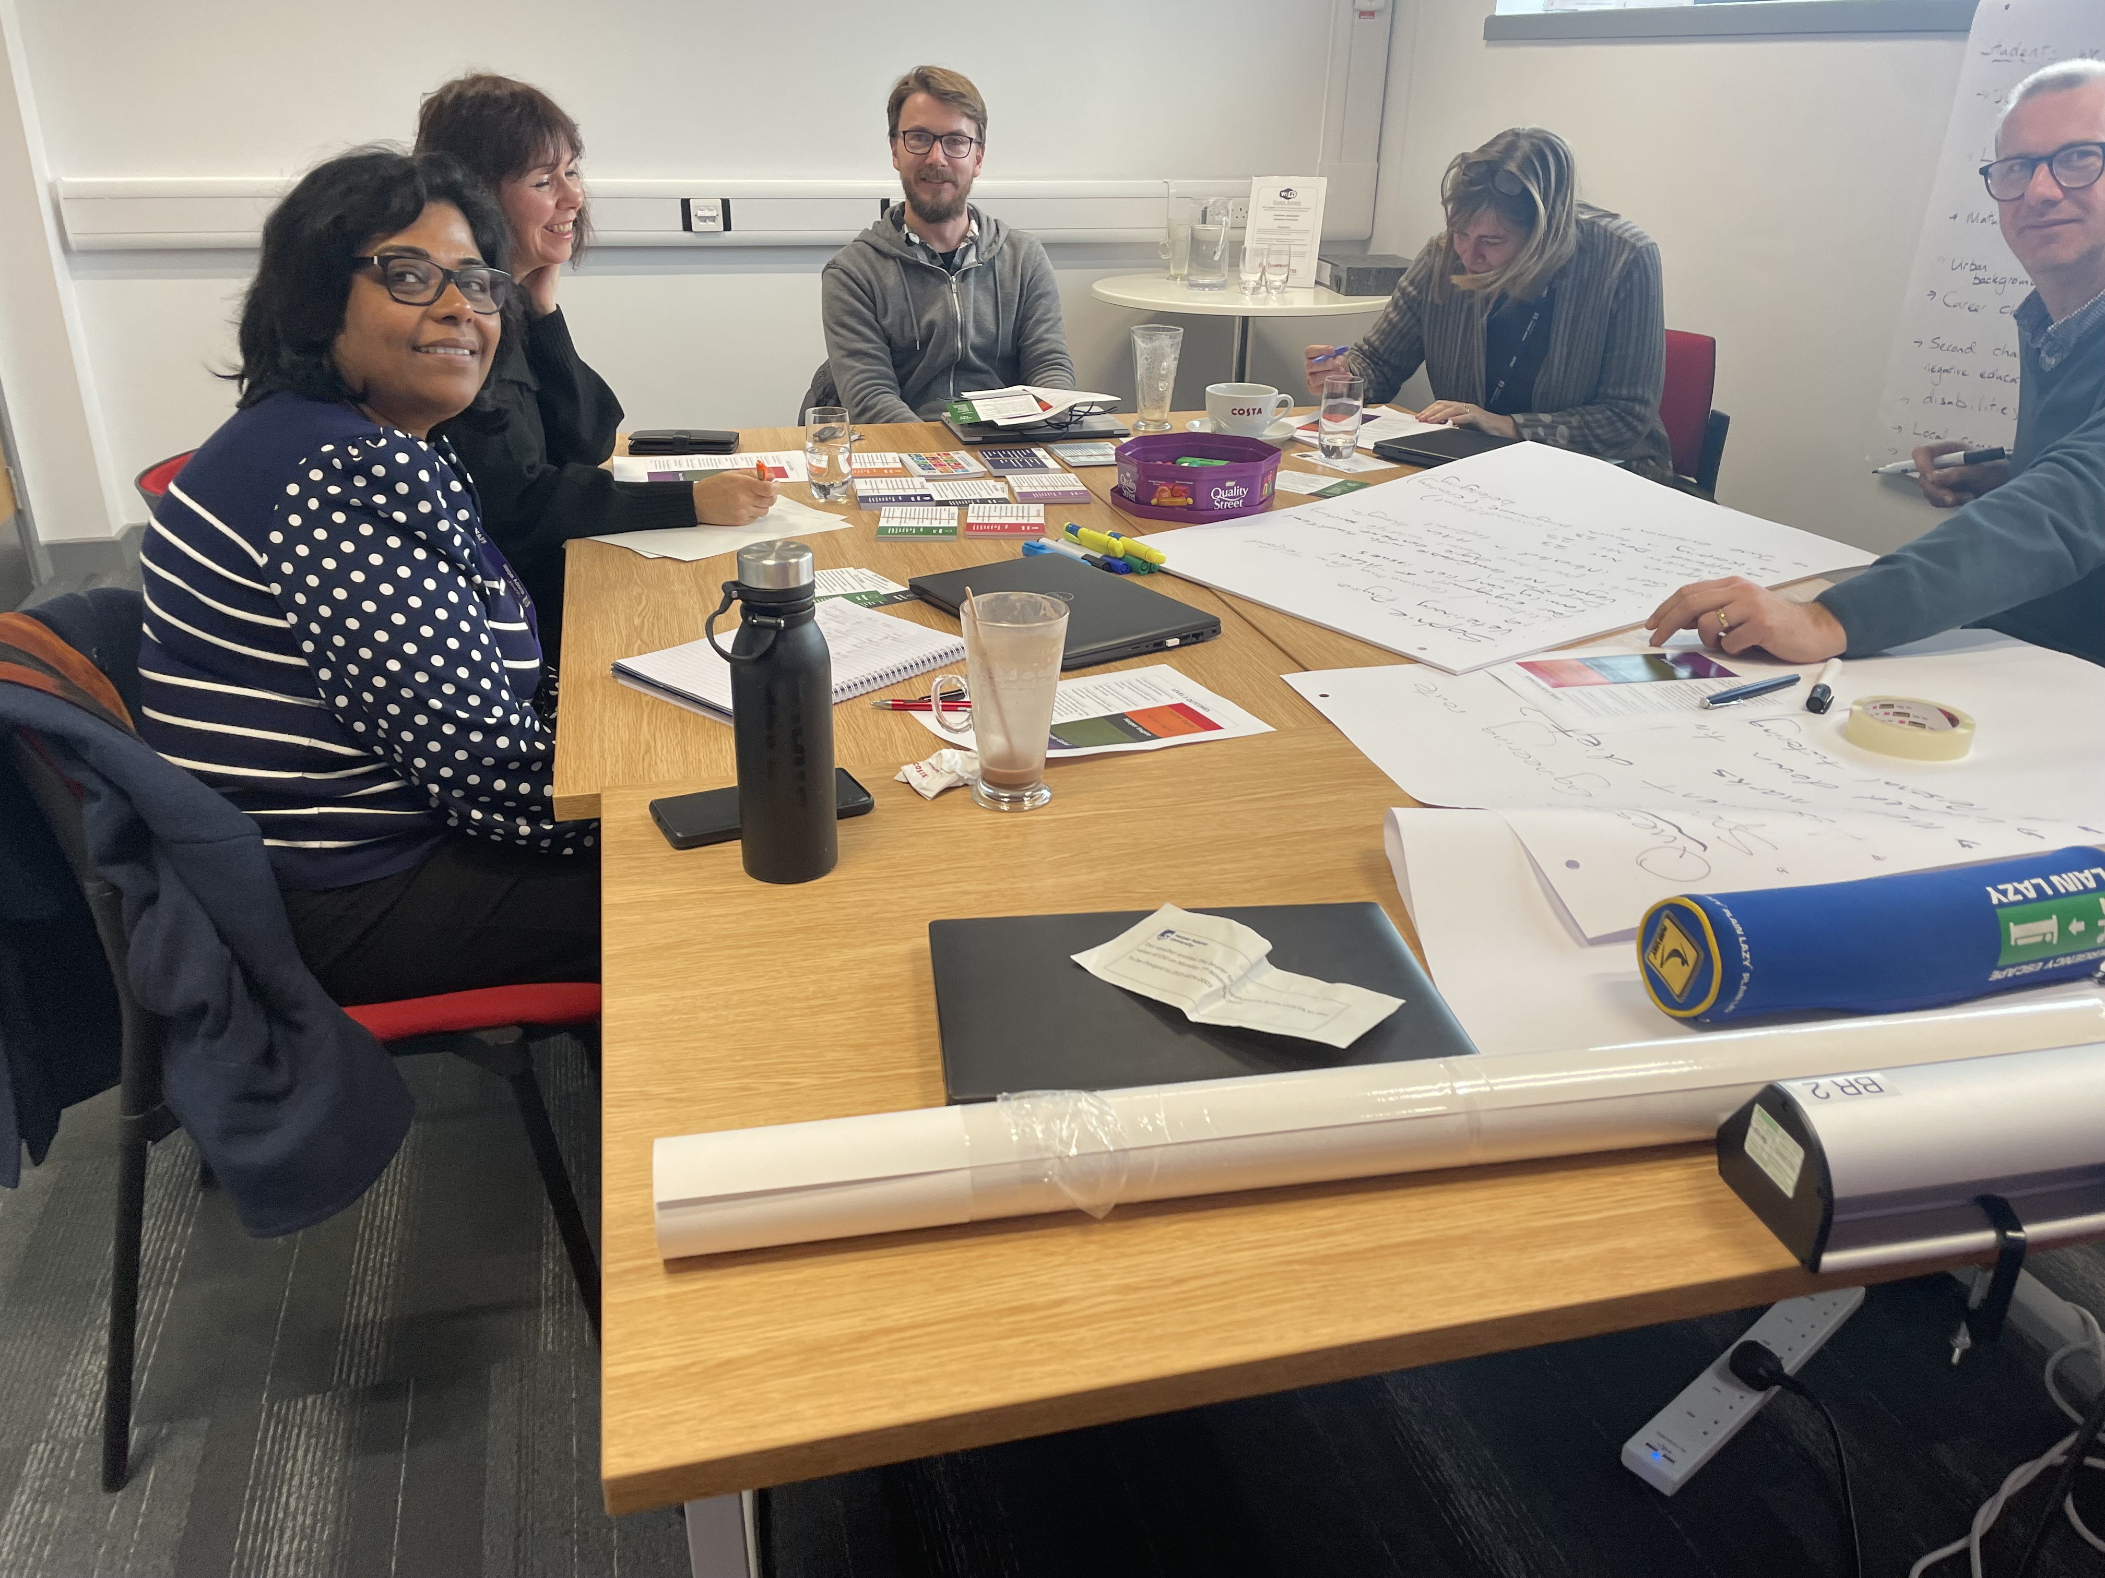
Team planning
Smucker (2022) discusses the role of collaborative planning
Diverse teams
  What does that mean?
Space and time to plan
Programme level thinking
Lose territories

Slide 13
Menti
What teaching methods and techniques would you recommend?
Menti.com enter code 28 16 11 5

Slide 14
Some practical ideas - for content design
“[E]mpower students to speak, to share their experiences, and draw on their existing knowledge” (Hulme et al, 2022)
  Could Phenomenon based learning help?
Choice
Embed skills to allow success with mastery
Create space – to be flexible
Actively seek global ideas (this is not always easy – with the erosion of scholarship due to workload and beaurocracy)
Create space for interaction within and between courses
Get feedback – and really hear it
Remember the basics – digital accessibility ….
Consider how we spend time – active choices about what is in and what is out!
Consider representation of ideas
Consider activities that foster respect – do not shy away from the difficult

Slide 15
Teaching methods of inclusion
Stay and go – baseline and repeat teaching
Weekly quizzes to promote engagement
Choice in species/business/estate – but too much choice may be bad!
Feedback to prevent misconception
Teach each other (recognising prior knowledge)
Teach reading and skills assumed
Glossary (prior study)
(whose needs am I serving) – commuters, apprentices, BTEC

Slide 16

Example: Case study (Hulme et al. (2022))
Psychology research methods
Reflection on practice
  Concepts may be excluding or triggering
  Formats (written vs video) may privilege
  Content of data sets
  Ways of interacting (engagement culture)
  Solutions – student partnership, choice in resources, active teaching
  Meta-themes – care, communication, reflection, self-awareness, questioning

Slide 17
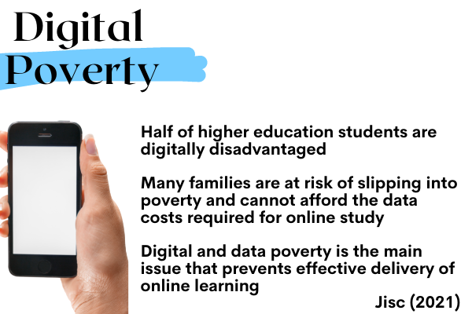
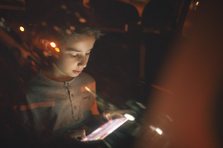
Notes:
Reference https://www.jisc.ac.uk/news/government-action-called-for-to-lift-he-students-out-of-digital-poverty-18-jan-2021

Slide 18

Practically – mind your language
Experience of sloppy language can hurt
‘You all studied this in A’Level’
‘When you are all in the bar later’
‘You can all relate to this family issue’
Facilitation needs to be sensitive

Slide 19
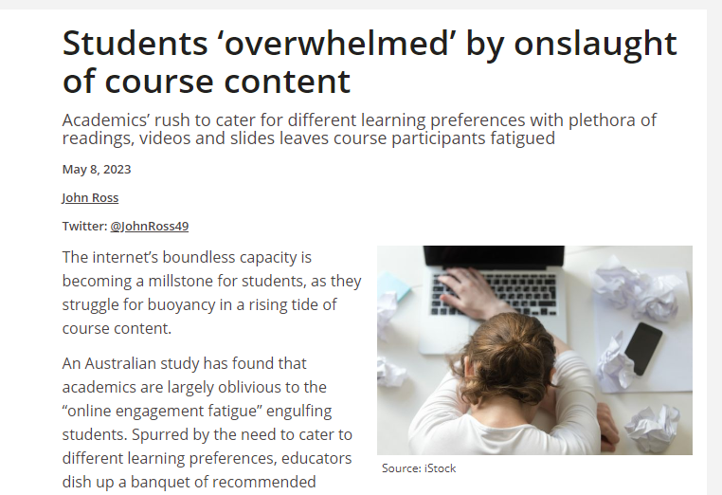
Space
“An Australian study has found that academics are largely oblivious to the “online engagement fatigue” engulfing students. Spurred by the need to cater to different learning preferences, educators dish up a banquet of recommended readings, videos, online forums, course announcements and weekly lecture recordings”.
“We’ve got all these fancy course specs and it’s all mapped, but at the end of the day, what’s my goal here? What can I do for these students to help them understand?”

Slide 20
What does an inclusive curriculum look like in the 21th Century
Meeting the needs of diverse learners
Using diverse and interactive teaching methods
Underpinned by thoughtful, compassionate and reflective engagement
Developed with a broad range of stakeholders
Rich in space
Underpinned by a learning community
Bravely addressing issues
There is much to do!

Slide 21
Challenges: Inclusive curriculum
Time
Staff workload
Lack of experience
Lack of confidence
Professional Bodies (lack of space)
Tokenism (meaningful decolonisation – decolonise the mind)
Discipline traditions
Whole student experience(s)
Inability to step away from oneself
Fear to reveal concerns and questions (a dominant narrative)
Institutional support – space and ‘try it twice’
What else?

Slide 22
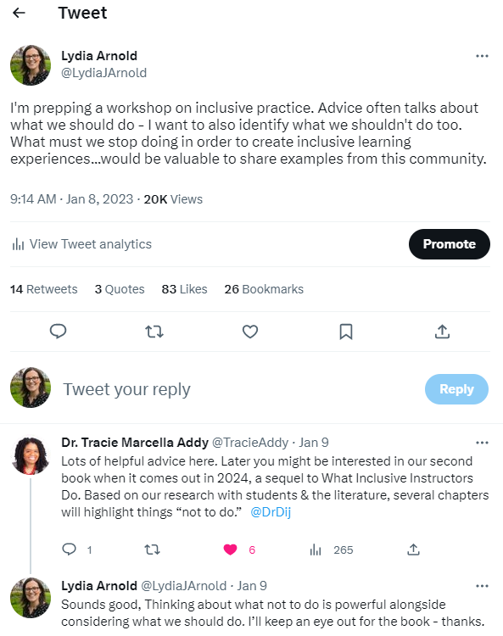
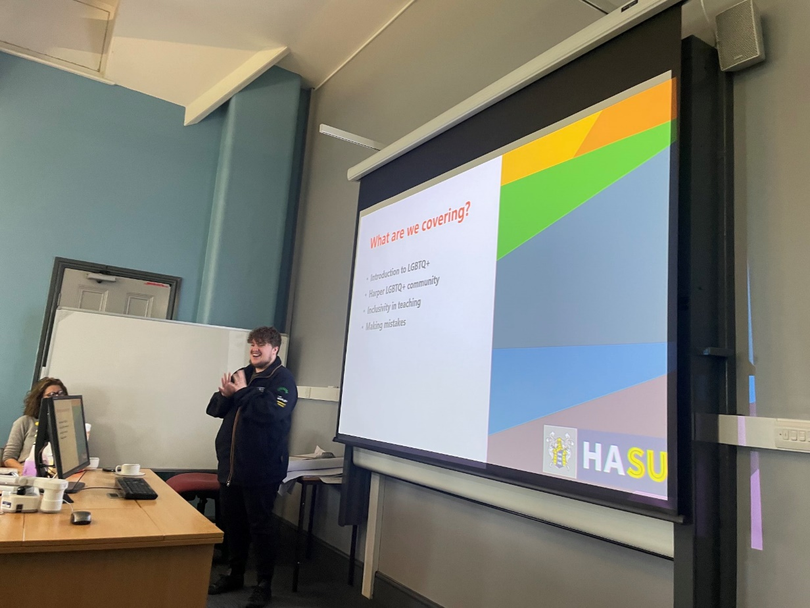
Engagement to overcome challenges

Slide 23

MUST BE FOR Students AND Staff

Slide 24
What does an inclusive curriculum look like in the 21th Century
Meeting the needs of diverse learners
Using diverse and interactive teaching methods
Underpinned by thoughtful, compassionate and reflective engagement
Developed with a broad range of stakeholders
Rich in space
Underpinned by a learning community
Bravely addressing issues
With self compassion and realisation about the limits of our endeavour

Slide 25
References
Baker, C. R., & Logan, L. B. (2006). USING ACTION RESEARCH TO PROMOTE INCREASED ACADEMIC SUCCESS FOR EDUCATIONALLY DISADVANTAGED STUDENTS. Global Perspectives on Accounting Education, 3, 1. https://www.proquest.com/scholarly-journals/using-action-research-promote-increased-academic/docview/203144276/se-2?accountid=11814
Hulme, J. A., McDermott, H., & Kent, A. (2022). Truly inclusive education: Teaching qualitative methods in psychology to enhance inclusion in the higher education psychology curriculum. QMiP Bulletin, 1(34), 22–29. https://doi.org/10.53841/bpsqmip.2022.1.34.22
Rossouw, N., & Frick, L. (2023). A conceptual framework for uncovering the hidden curriculum in private higher education. Cogent Education, 10(1). https://doi.org/10.1080/2331186X.2023.2191409
Smucker, A. D. (2022). Exploring the growth of inclusive curriculum: a systematic review of scholar and practitioner perspectives. International Journal of Inclusive Education, 0(0), 1–15. https://doi.org/10.1080/13603116.2022.2121988
Stentiford, L., & Koutsouris, G. (2022). Critically considering the ‘inclusive curriculum’ in higher education. British Journal of Sociology of Education, 43(8), 1250–1272. https://doi.org/10.1080/01425692.2022.2122937
Thomas, L., & May, H. (2010). Inclusive learning in higher education. In Enhancing Teaching in Higher Education. HEA. https://doi.org/10.4324/9780203416006_chapter_16

