Slide 1
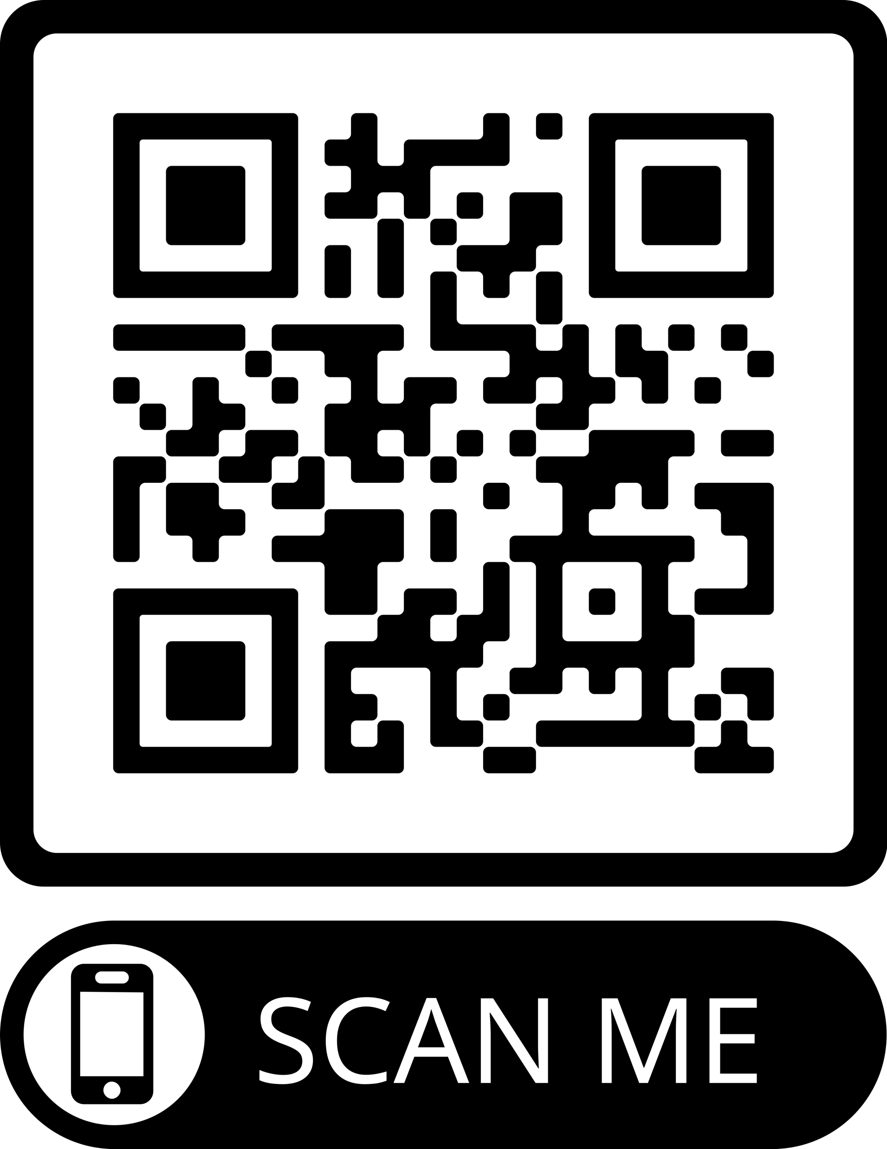
Meeting tomorrow’s challenges with Authentic Assessment Principles
Professor Lydia Arnold
University of Teesside, 2024
@LydiaJArnold | lydiaarnold.net | LinkedIn: lydiajarnold
Notes:
The abstract with key take away messages – 100 words
This session will build on the event's themes by considering how assessment can help universities prepare graduates for an uncertain and dynamic future.
It will explore how well-designed assessments have the power to both inspire and develop individuals.
The talk recognises the challenging environment of higher education and the barriers to achieving an optimised assessment landscape.
To offer a way forward, we will explore the question: How do we create the conditions for authentic assessment? We will touch on leadership, culture, community, and connection as being key to unlocking a future-fit assessment environment.
The session concludes with a call to action for us to each play our part in determining the future of assessment.

Slide 2

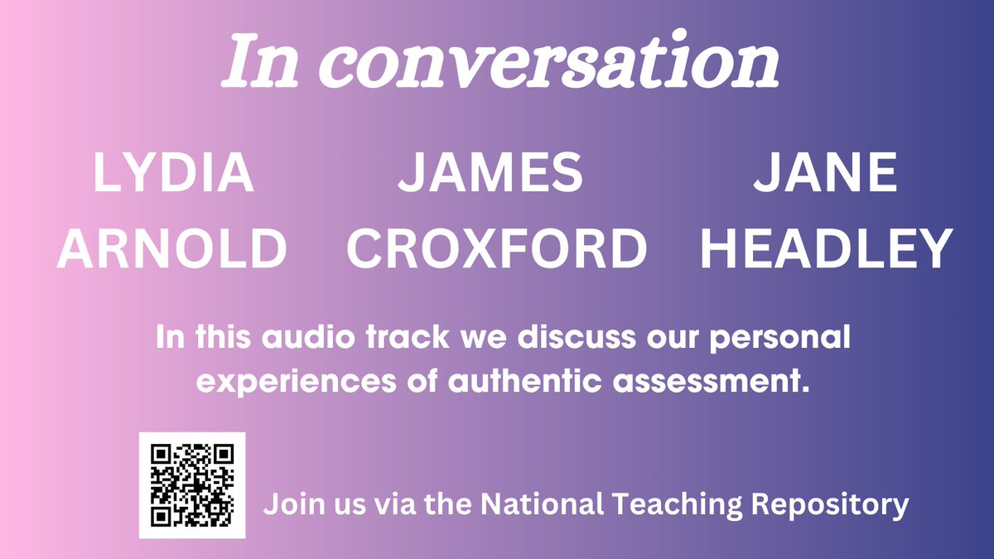
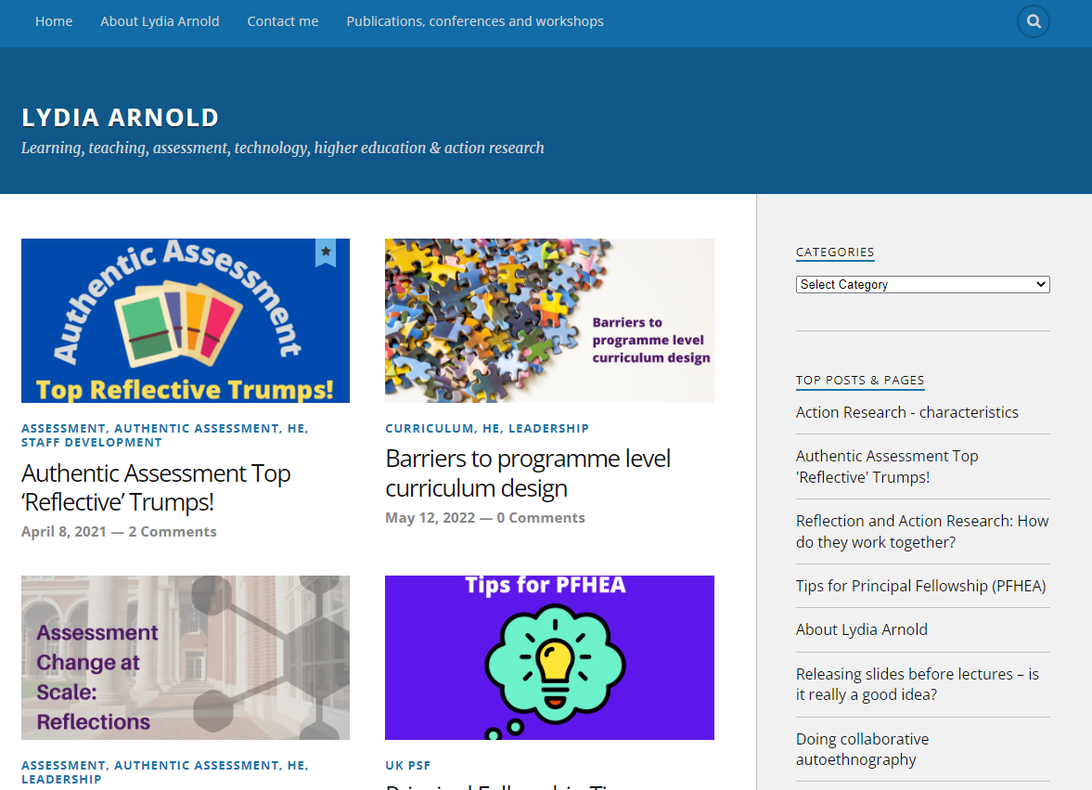
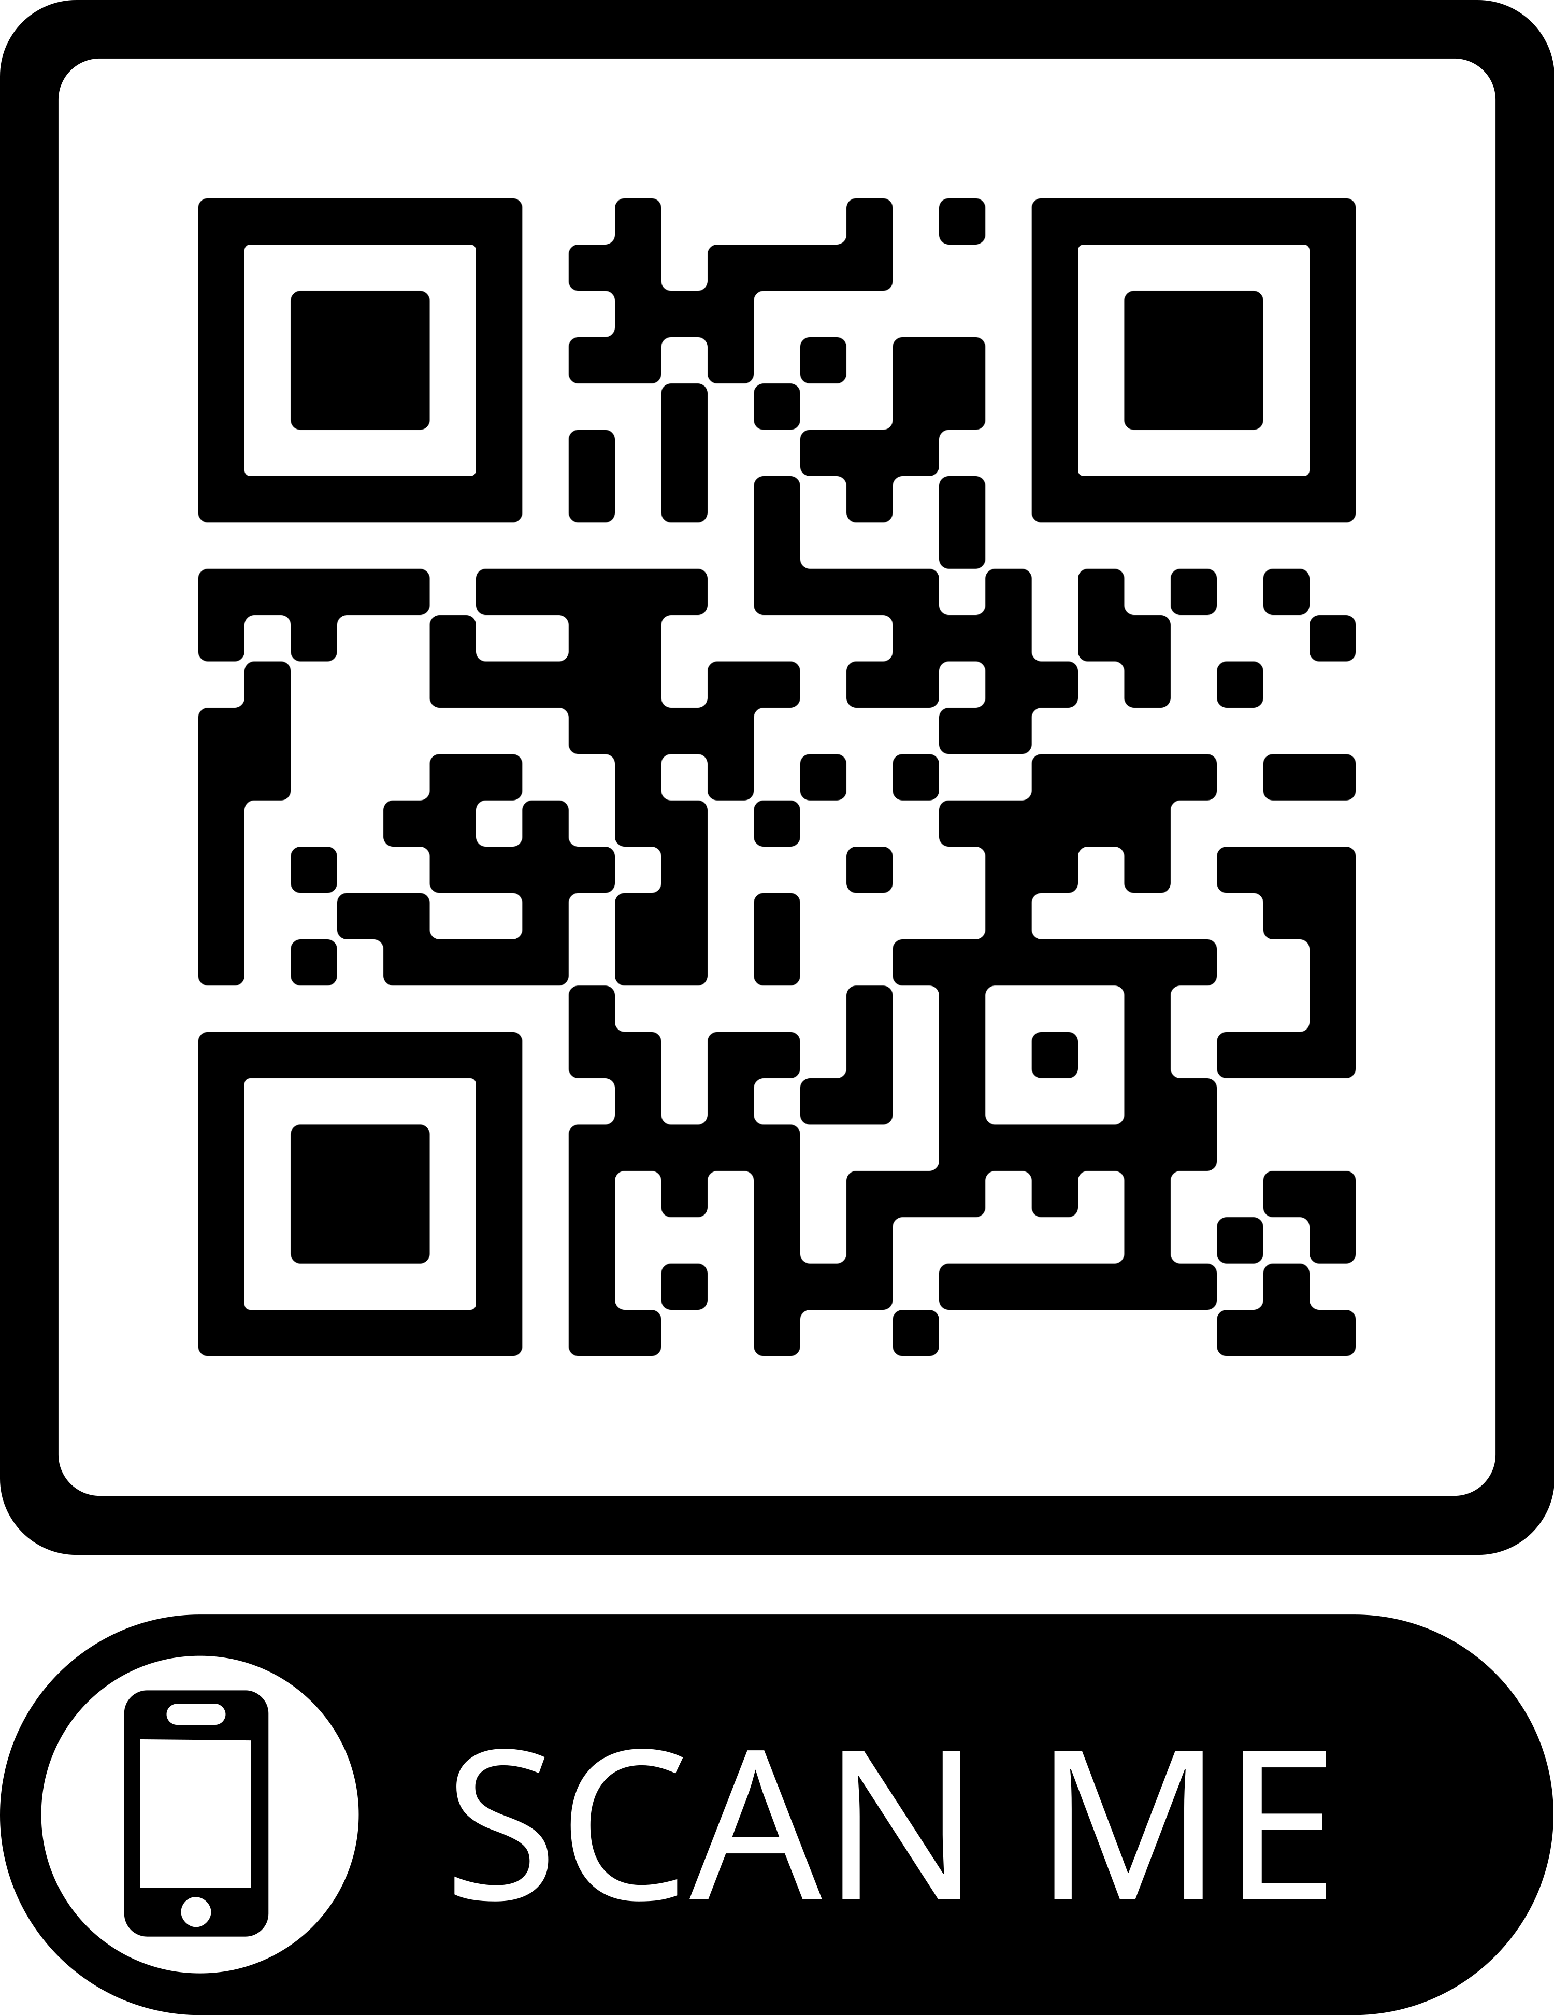
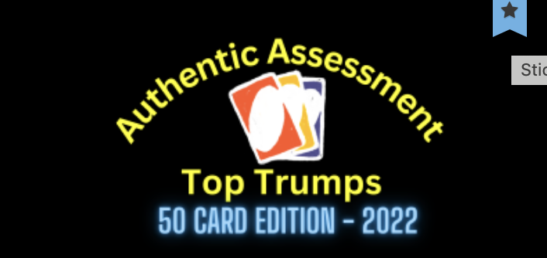

Slide 3
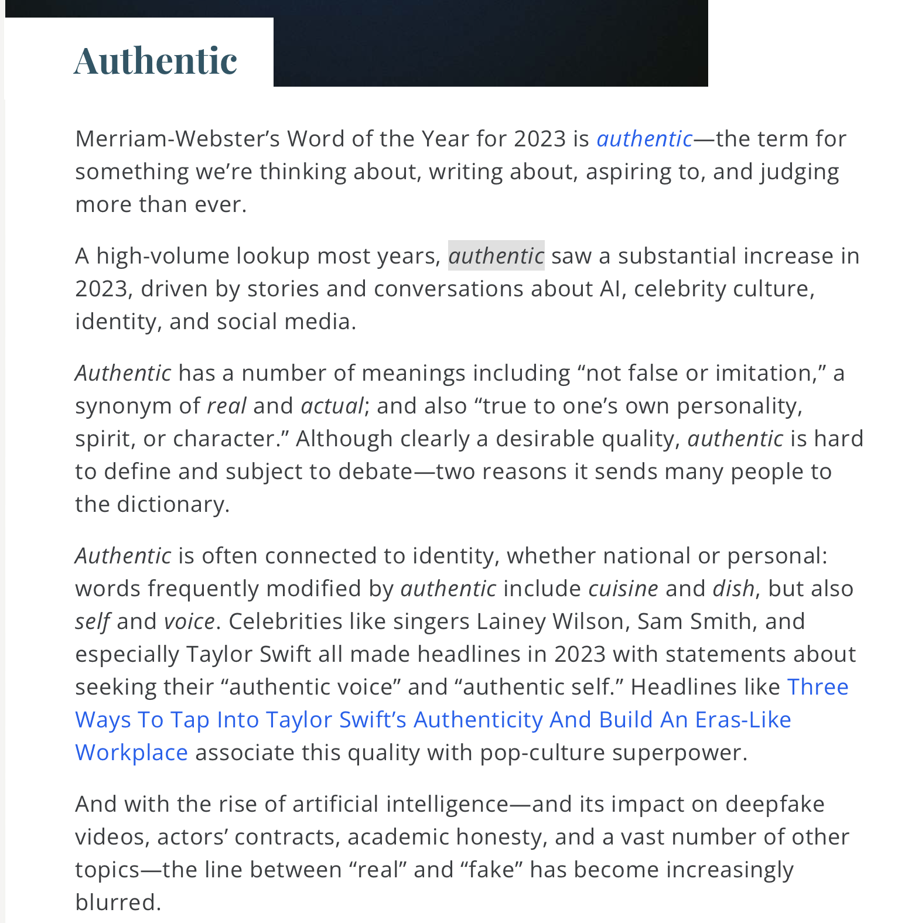
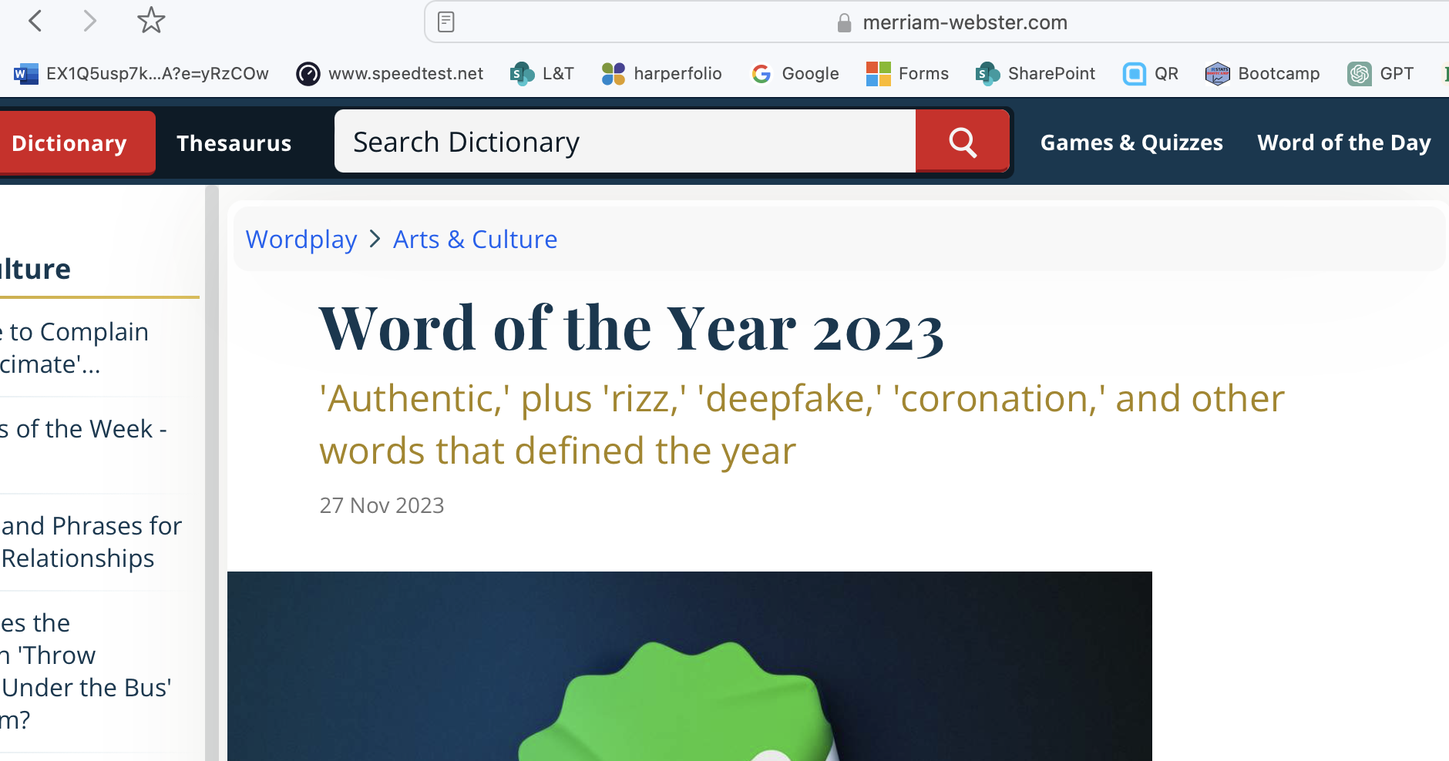
Word of the year 2023: Authentic

Slide 4
Ask colleagues ….
Real world
Like work
Projects
Uncheatable
Creative
Anything that’s not an essay, report or exam
Something students want to do
Like students would do after graduation
Involves student choice
Must engage [i.e. no faking good]
Makes a difference

Slide 5

Ask students ….

Slide 6

What is authentic assessmnet?
Employability (real, like work)
Discipline (growing in discipline)
Self (as I wish to become)
Relevant to me, us and them
But what is relevant?

Slide 7

Is ‘academic’ a dirty word?
What skills, qualities and knowledge is needed?
Academic vs ‘Real’ world
Can academic help?

Slide 8
What is authentic assessment?
Relevant to future employment
Relevant to the advancement of the discipline
Relevant to our collective future
Relevant to individual aspiration
Often mirrors real, complex challenges
Results in diverse outputs
Equips students to work with uncertainty
Causes students to reflect meaningfully on their learning
Focus on ‘process’ as well as product

Slide 9
Benefits
Assessment for learning
Motivating for students
Higher order cognitive skills
Develops a wide range of skills
Interesting and rewarding for staff
Helps fight cheating*
Can feed into real world challenges when paired with industry
Maybe rich in wider attributes as well as content learning
Can inspire teaching approaches
“students tend to engage more deeply, and potentially achieve higher marks overall, when they are provided with assessment activities requiring them to go well beyond what traditional approaches required” [Brown and Sambell 2023]

Slide 10
Challenges or barriers
Risk of utilitarian narrative (remember self)
Time in preparation
Do subjects align with a career?
Support needs to be aligned
Facilities can be limiting
Regulations (perception)
Loss of control
Out of touch versions of authentic
Glossing adds complexity
Phsycological Safety and comfort (Wake et al, 2023)

Slide 11
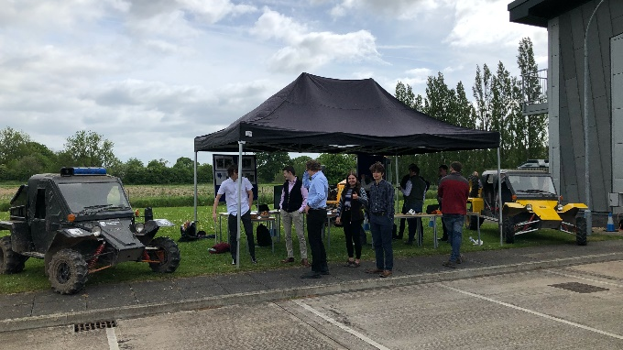
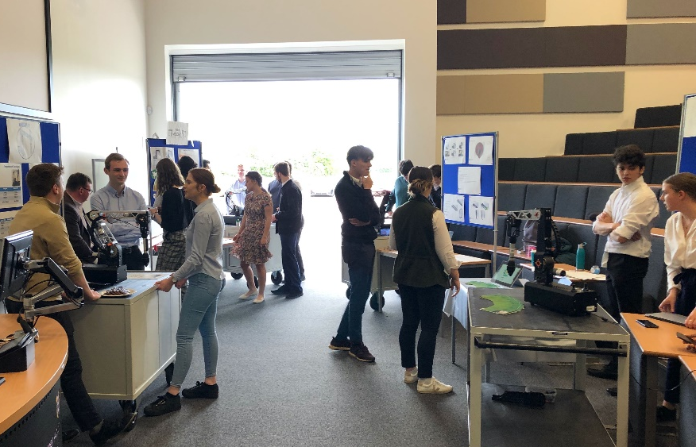
Example: Trade Show and Exhibition
Students undertake a product development design challenge
Student groups ‘sell’ their product to industry
Industry guests can only purchase one, but can express interest in others
A portion of the marks are directly related to whether students ‘make a sale’
Submitted by: James Croxford

Slide 12
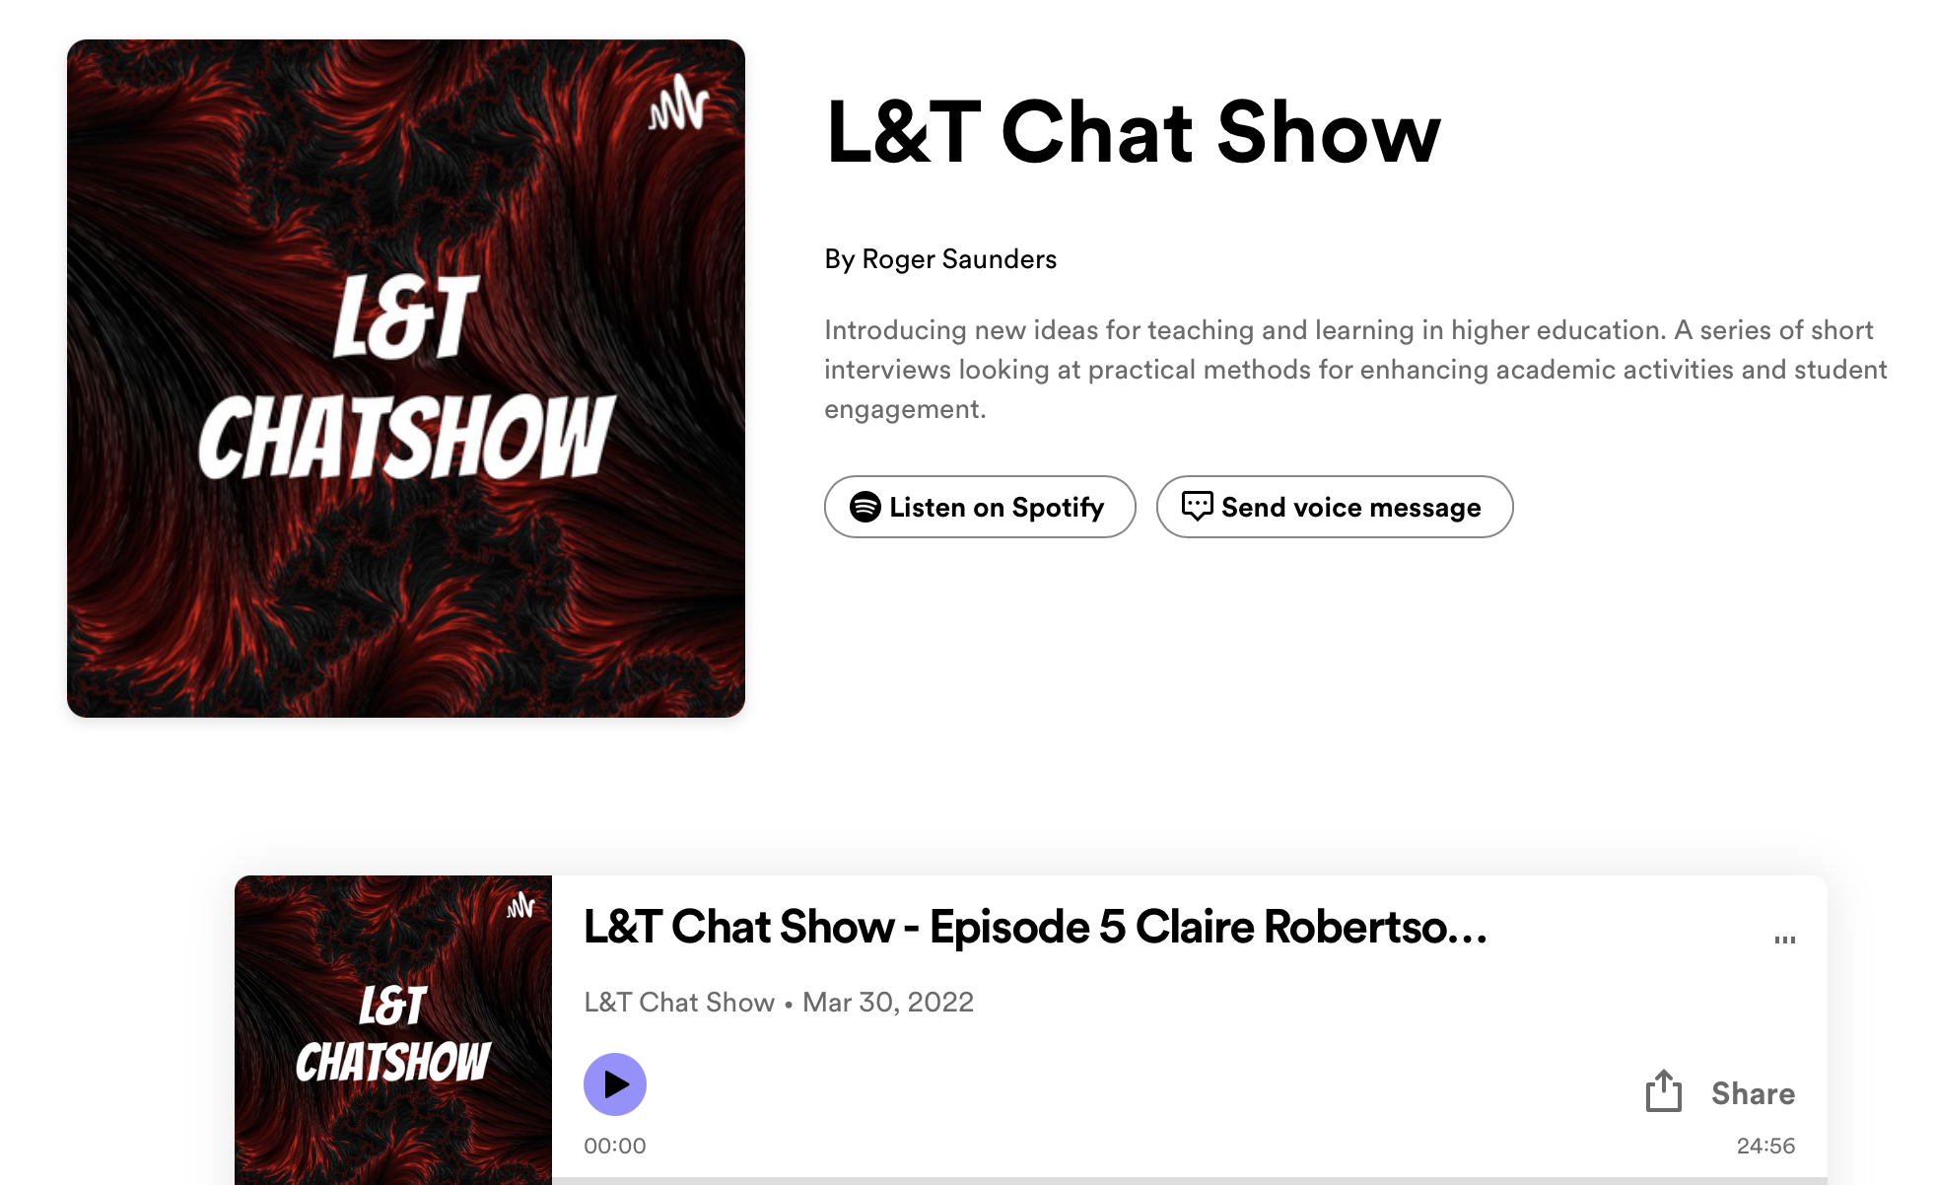
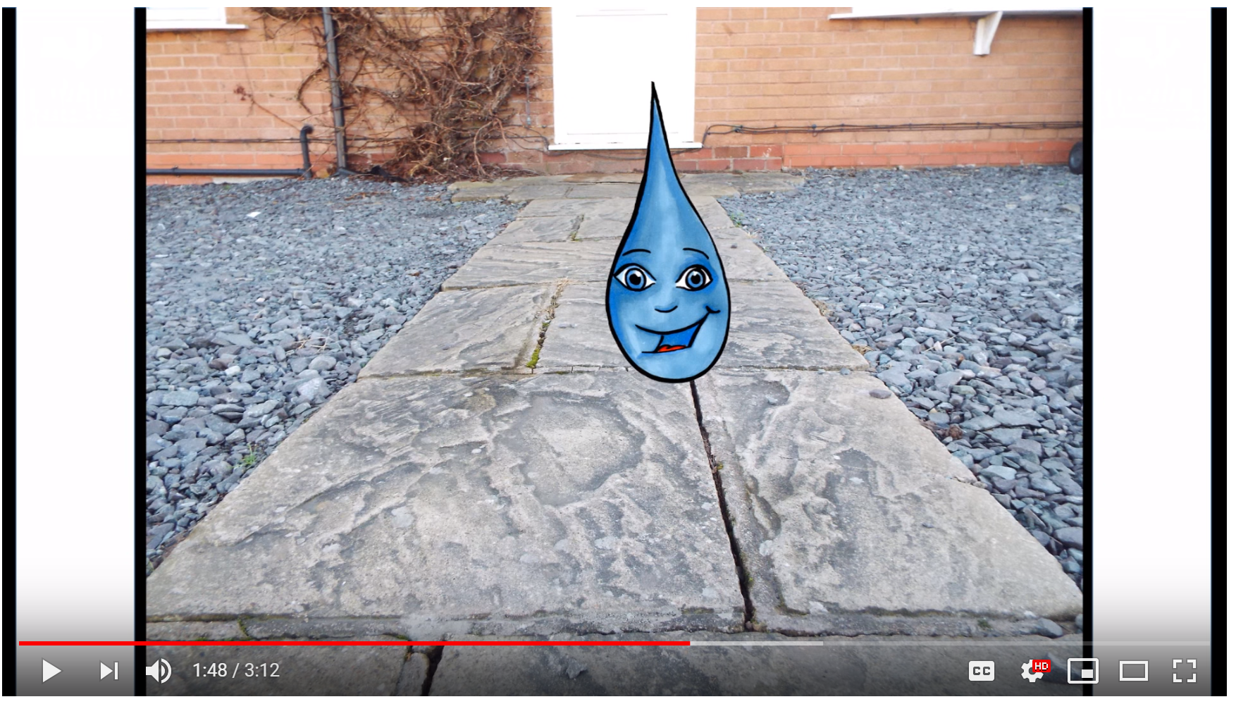
Live Project
Student projects
Pair with local organisations
Create and manage video products
Team function (team problems)
The pedagogy of facilitation
Marked by process and product and meta-reflection
Exhibition
Submitted by: Emma Tappin

Slide 13
Reality: A spectrum of authentic activity
Practice Nudges
EXHIBITION
RESEARCH CONFERENCE
Audience
Perceived risk
Authenticity
PRESENTATION
PODCAST
VIRTUAL SIMULATION
ONLINE DEBATE
SCENARIO BASED EXAMS
GUEST SPEAKERS
Tutor Control and Simplicity
Resource

Slide 14
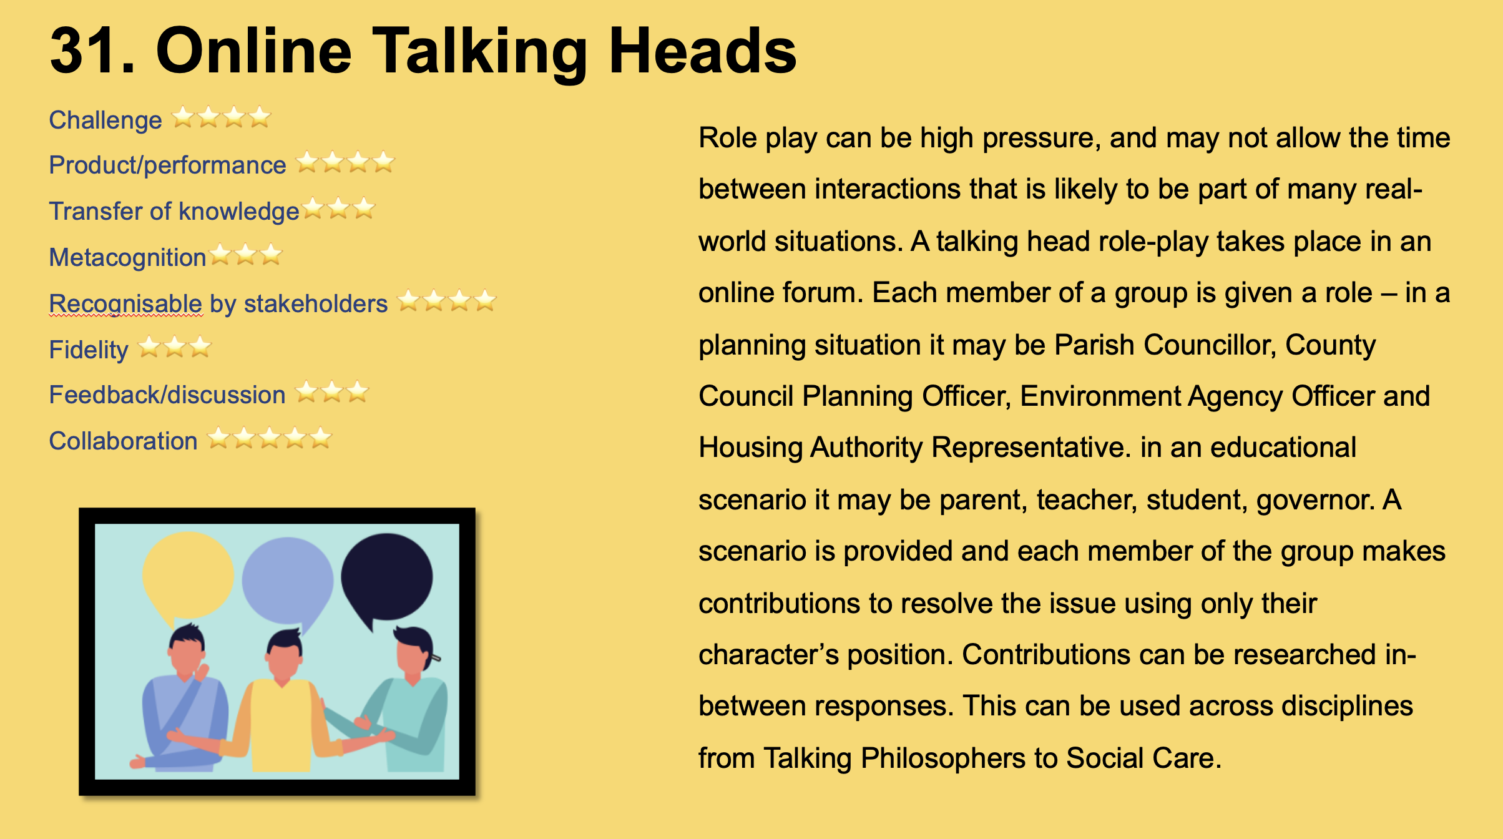
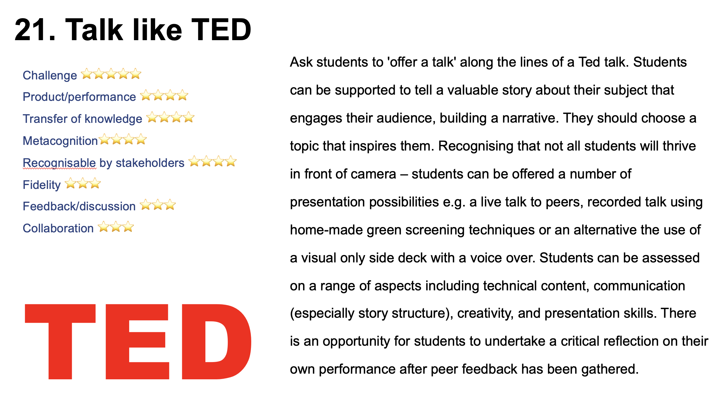
Examples matter
Notes:
Heads – Public health planning group; contingency for energy security

Slide 15

Is authentic a panacea in the age of AI

Slide 16
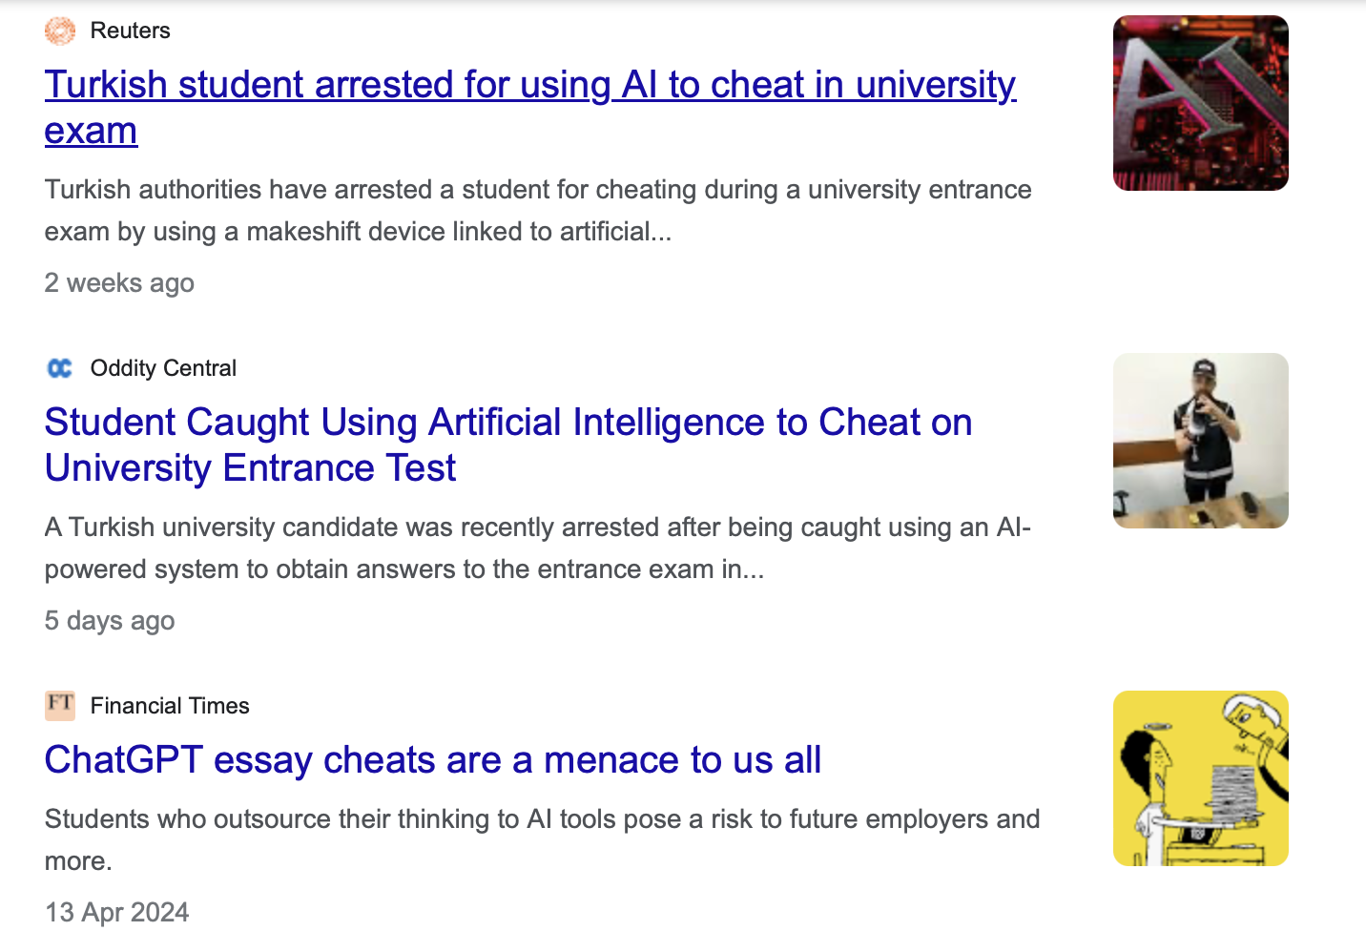
Assessment security in an age of AI
How do we know graduates have the skills that they claim?

Slide 17

How does AI relate to the skills of the future in assessment?
I've never ever, ever taken anything that's written by AI and put it straight into an assignment. Use the ideas put forth by AI, maybe the basic points and principles, expand on that and find references that support that.
it was just such a really good aid. It's no different than talking to a peer. And saying, Oh, what did you write about?

Slide 18

How does AI relate to the skills of the future in assessment?
With exams as the main type of assessment - not a skill that’s needed [but what of the future?]
Set ways of working and no time to invest in new ways.
Fear of being accused of cheating

Slide 19
When have you used AI more than you should?
The over complex ‘authentic’ assessment
The traditional assessment with too much pressure
AI use is shaped by the conditions and assessment design.
Makes the case for good design and support.
Is inappropriate use much different than an essay mill?

Slide 20
Assessment reform for the age of artificial intelligence (TESQA, 2023)
Assessment should emphasise...
Appropriate, authentic engagement with AI
A systemic approach to program assessment
The process of learning
Opportunities for students to work appropriately with each other and AI
Security at meaningful points across a program to inform decisions about progression and completion
Notes:
https://www.teqsa.gov.au/sites/default/files/2023-09/assessment-reform-age-artificial-intelligence-discussion-paper.pdf

Slide 21
Provocation: Is it time to stop talking about authentic?
What do we mean?
(Arnold & Croxford, 2024, In Press)
Enjoyable
Interesting
Creative
Collaborative
Reflective
Discipline based
Professionally aligned
Active
Impactful
Confidence building
High level of demand
Uses the tools of employers

Slide 22
Enablers of authentic future-fit assessment
Course design
Programmatic thinking
Preparatory support
Pedagogic outlook
Alignment of approach
Technology
Development of evaluative judgment
Criteria
Exemplars
Dialogue
Institutional alignment
Enabling regulations
Backwards engineering (Outcomes driven)
Feedback
Resource
Supportive colleagues
Dual professionals
Staff development
Staff development
Risk appetite
Strategy
Security
Staff skills

Slide 23

Staying relevant (Dual professionals, sabbaticals, industry connections, diverse staff, multi-stakeholder curriculum)
“Increases in the pace of change in society, widening socio-economic gaps, and the challenges experienced by upcoming generations of learners, means that convergence in perspective around what an authentic assessment even is, may simply become ever more difficult to reconcile”. Arnold & Croxford (2024, InPress)

Slide 24
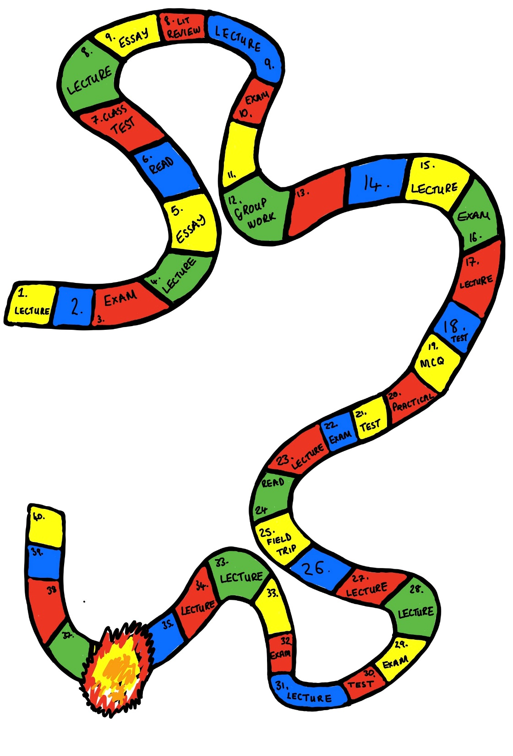
Programmatic thinking for pedagogy
Programmatic design ‘involves team decisions
It builds ‘more integration’ (Jessop 2019, p43).
Less risk of gaps?
No surprises please!

Slide 25
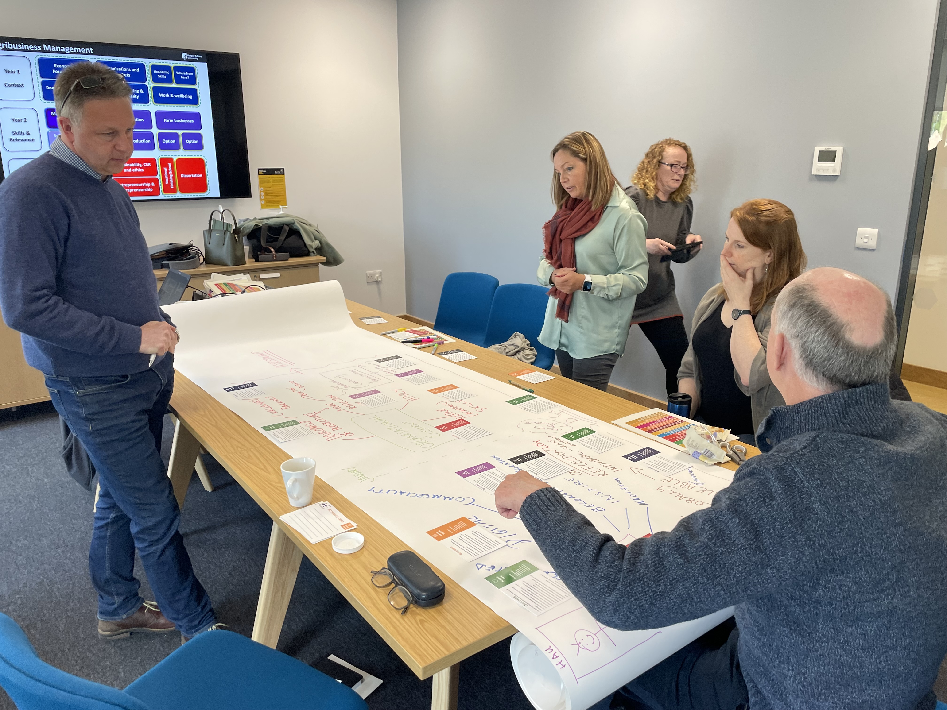
The blueprinting methodology
From team to programme
Day 1: Vision Building
Day 2: Programme
Day 3: Module commissioning
25

Slide 26
The pedagogy of letting go
I’m not sure how this is going to go, how students will react and whether they will learn all of the content that we usually cover
I never thought students would produce such excellent work. It’s all different, but good. I worried that they wouldn’t come through.

Slide 27
It really is so much more enjoyable having a module where it is possible to engage directly with groups and individuals, as you get to know many more students as people rather than passive faces in a lecture theatre, with the benefit that those who were struggling were identified and supported at a much earlier stage.

Slide 28

Regulations

Slide 29
Conclusion
Assessment is a set of balanced choices
Share
Programme level thinking
Institutional conditions matter
Beyond utility – the outside world changes, fast!
Evidence – be critical and consider contributing
Respect and cooperation between academic and industry

Slide 30
References
See Notes for a full list
Notes:
Ajjawi, R. et al. (2019) ‘Aligning assessment with the needs of work-integrated learning: the challenges of authentic assessment in a complex context’, Assessment and Evaluation in Higher Education. Routledge. doi: 10.1080/02602938.2019.1639613.
Arnold, L. (2016) The process of defining graduate attributes, LydiaArnold.net. Available at: https://lydiaarnold.wordpress.com/2016/10/03/the-process-of-defining-graduate-attributes/ (Accessed: 11 September 2019).
Arnold, L. & Headley, J. (2019). How can we work with exemplars? Collated ideas from an institutional community of practice. Educational Developments, 20.3 p24-28.
Arnold, L. and Norton, L. (2018) HEA Action Research: Practice Guide About the authors. York: HEA. Available at: https://www.heacademy.ac.uk/knowledge-hub/action-research-practice-guide/.
Arnold L., Thompson, K. & Williams, T. (2009). Advancing the Patchwork Text: The Development of Patchwork Media Approaches. The International Journal of Learning, Volume 16, Issue 5, pp.151-166.
Ashford-Rowe, K., Herrington, J. and Brown, C. (2014) ‘Establishing the critical elements that determine authentic assessment’, Assessment and Evaluation in Higher Education, 39(2), pp. 205–222. doi: 10.1080/02602938.2013.819566
Birch, P., Batten, J. and Batey, J. (2016) ‘The influence of student gender on the assessment of undergraduate student work’, Assessment and Evaluation in Higher Education. Routledge, 41(7), pp. 1065–1080. doi: 10.1080/02602938.2015.1064857.
Bretag, T. et al. (2019) ‘Contract cheating and assessment design: exploring the relationship’, Assessment and Evaluation in Higher Education. Routledge, 44(5), pp. 676–691. doi: 10.1080/02602938.2018.1527892.
Brown, S. (2019) ‘Using assessment and feedback to empower students and enhance their learning’, in Bryan, C. and Clegg, K. (eds) Innovative Assessment in Higher Education. 2nd edn. Oxford: Routledge, pp. 50–63.
Cummings, J., and G. Maxwell. 1999. “Contextualising Authentic Assessment.” Assessment in Education: Principles, Policy & Practice 6 (2): 177–194. doi:10.1080/09695949992865.
Dawson, P. (2017) ‘Assessment rubrics: towards clearer and more replicable design, research and practice’, Assessment and Evaluation in Higher Education. Routledge, 42(3), pp. 347–360. doi: 10.1080/02602938.2015.1111294.
Gibbs, G. (2019) ‘How assessment frames learning’, in Bryan, C. and Clegg, K. (eds) Innovative Assessment in Higher Education. Oxford: Routledge, pp. 22–35.
Ion, G., Sánchez Martí, A. and Agud Morell, I. (2019) ‘Giving or receiving feedback: which is more beneficial to students’ learning?’, Assessment and Evaluation in Higher Education. Routledge, 44(1), pp. 124–138. doi: 10.1080/02602938.2018.1484881.
Jessop, T. (2019) ‘Changing the narrative: a programme approach to assessment through TESTA’, in Bryan, C. and Clegg, K. (eds) Innovative Assessment in Higher Education. 2nd edn. Ox: Routledge, pp. 36–49.
McDowell, Liz, Sambell, Kay and Davison, Gillian (2009) Assessment for learning : a brief history and review of terminology. In: Improving Student Learning Through the Curriculum. Oxford Centre for Staff and Learning Development,
Lui, D and Bridgeman, A. (2023) What to do about assessments if we can’t out-design or out-run AI? https://educational-innovation.sydney.edu.au/teaching@sydney/what-to-do-about-assessments-if-we-cant-out-design-or-out-run-ai/
Oxford, pp. 56-64. ISBN 1873576786
Maxwell, T. W. (2012) ‘Assessment in higher education in the professions: action research as an authentic assessment task’, Teaching in Higher Education, 17(6), pp. 686–696. doi: 10.1080/13562517.2012.725220.Mcdowell, L., Sambell, K. and Davison, G. (no date) Assessment for learning : a brief history and review of terminology. Available at: http://www.shu.ac.uk/_assets/pdf/2331LTAreportinorder.pdf.
Nikolic, S., Daniel,S., Haque, R., Belkina, M., Hassan, G.M., Grundy, S., Lyden, S., Neal, P., & Sandison, C. (2023) ChatGPT versus engineering education assessment: a multidisciplinary and multi-institutional benchmarking and analysis of this generative artificial intelligence tool to investigate assessment integrity, European Journal of Engineering Education, 48:4, 559-614, DOI: 10.1080/03043797.2023.2213169
Stein, S. J., Isaacs, G. and Andrews, T. (2004) ‘Incorporating authentic learning exp Wiggins, G., and J. McTighe. 2006. “Examining the Teaching Life.” Educational Leadership. 63 (6): 26–29
Torrance, H. 1995. Evaluating Authentic Assessment. Buckingham: Open University Press.
Villarroel, V. et al. (2018) ‘Authentic assessment: creating a blueprint for course design’, Assessment and Evaluation in Higher Education. Routledge, 43(5), pp. 840–854. doi: 10.1080/02602938.2017.1412396.
Villarroel, V. et al. (2019) ‘Using principles of authentic assessment to redesign written examinations and tests’, Innovations in Education and Teaching International. Routledge, 00(00), pp. 1–12. doi: 10.1080/14703297.2018.1564882.
Watkins, D., B. Dahlin, and M. Ekholm. 2005. “Awareness of the Backwash Effect of Assessment: A Phenomenographic Study of the Views of Hong Kong and Swedish Lecturers.” Instructional Science 33: 283–309.
Wiggins, G., and J. McTighe. 2006. “Examining the Teaching Life.” Educational Leadership. 63 (6): 26–29
Winter, R. and Sgoggins, J. (1999) ‘The Patchwork Text: A Coursework format for education as critical understanding', Teaching in Higher Education, Vol. 4, No.

