Slide 1

Leading Strategic Change in Assessment
Professor Lydia Arnold
Dr Iain McDonald

Slide 2
This session (9.20-10.40)
Why should leadership be a focus?
How it feels to be led
Key questions – What, How, Who
Pledges

Slide 3
Leadership matters – shared experience
Harper Forward
Difficult leadership – personally challenging
Everyone is right (of course they are!)
Curriculum and assessment are contested
Big picture view – beyond the programme
My moment of realisation to share: A letter of heart
Self-awareness – computer-based exams, authentic assessment.
As we make choices, how does it feel to be led?

Slide 4


Leading Institutional change in assessment and feedback policy and practice
Guiding assessment review – changes e.g. apprenticeships work based learning
Methodology – how do we get the change / constraints
Ripple effect of curriculum and assessment change

Slide 5
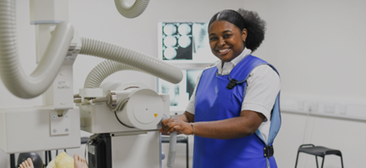
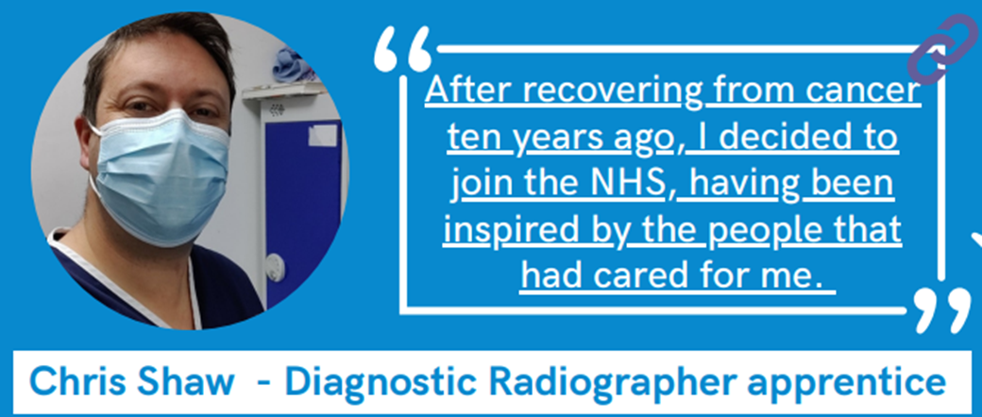
External forces: my experience of changing landscape
Before 2020: BSc in diagnostic radiography
After 2020 (Covid): emphasis on more radiographers – apprentice route leading to BSc + HCPC (Health and Care Professions) registration. Traditional route (TR) BSc continues
Very much work-based learning in the apprenticeship model

Slide 6

‘Letting go’ on assessment – maybe, but constraints & Departmental attitudes
If it ain’t broke don’t fix it. Emphasis on written exams and written assignments. Same for the last 25 years
Constrained by Professional body regulation. But after Covid – think creatively (as long as external examiner happy!) computer based online exams (now in-person)
Exams – less emphasis on equations and maths more on concepts – opening up course to those without science background.

Slide 7
Ripple effect: Authentic assessment – is valuable, particularly for work-based apprentices (distance learners).
New initiative - mid module surveys – very detailed but missed off assessment experience.
Formative mock exams – online preferred with feedback provided after (driven by distance learners)
Quality Assurance (formative) – collaborative wikis (until pulled by Blackboard) / Individual Blogs / collaborative posters
Real world issues ‘sustainable assessment’ – patient interviews / quality assurance. Aids completion of Practice Assessment Document. More interactions with qualified staff

Slide 8
Q1
What assessment principles would you prioritise when enacting a change programme? [and why?]

Slide 9
Possible ideas
Linked to employability
Future facing
Live challenges
Active learning
Manageable
Inclusive
Applied
Assessment for learning
Feedback by design
Efficient
Personalised
Balanced
Flexible
Change making
Authentic
Secure
Choice
Context matters
Consider strategy and mission.

Slide 10
Q2
How will you implement these principles in course development at scale?

Slide 11
Implementation
Rules
Guidance
CPD
Champions
Panels and events (Showcase)
Documentation and templates
Closing the gap
Language
Professional body relationships
Diverse teams
Trust
Scholarship and evidence
Data
External choices
Trailblazers
Test and evidence
Coupling or decoupling (interdependence)
Context matters
Consider strategy and mission.

Slide 12
Q3
Who needs to be involved in supporting assessment transformation to make sure that the change works in practice?
And how do you involve them?

Slide 13
Q4 Bonus
What skills and attributes will you as a leader need to manage large-scale assessment change, and how do you develop these?

Slide 14
Implementation- one team
Timetable and space managers
Facilities managers
Language experts
Marketing
Financial modelers
IT teams (processing)
Administrators
Learner support (Vantage points)
Academic Guidance
Technologists
Library colleagues
Professionals beyond the university
School or college students

Slide 15
Process lessons
Partnership is key
One-team approach brings meaningful change
Areas of focus matter, but so do areas of neglect
Momentum is hard to maintain
Communication. Communication. Communication
Communicate up, down, and outwards!
Get support yourself
Recognise the impact you can have; don’t be weighed down by it
Be honest about what’s not working well - no blame, recognise complexity

Slide 16
Your pledge(s)
What will you do now to effect positive change in your context?

